Slide 1
GHANA CALIBRATION
90 m

Slide 2
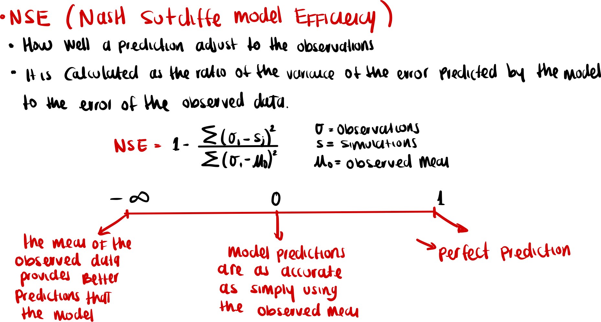
Notes:
Source trail

Slide 3
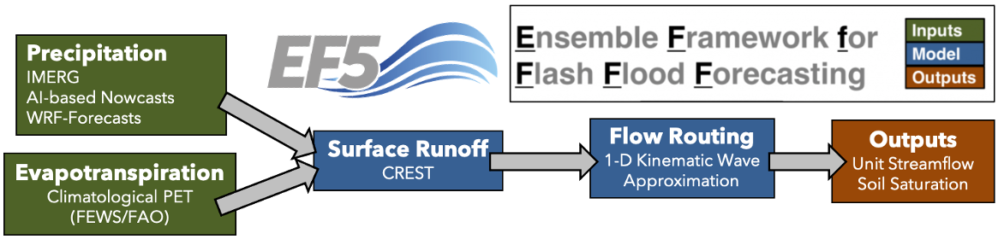
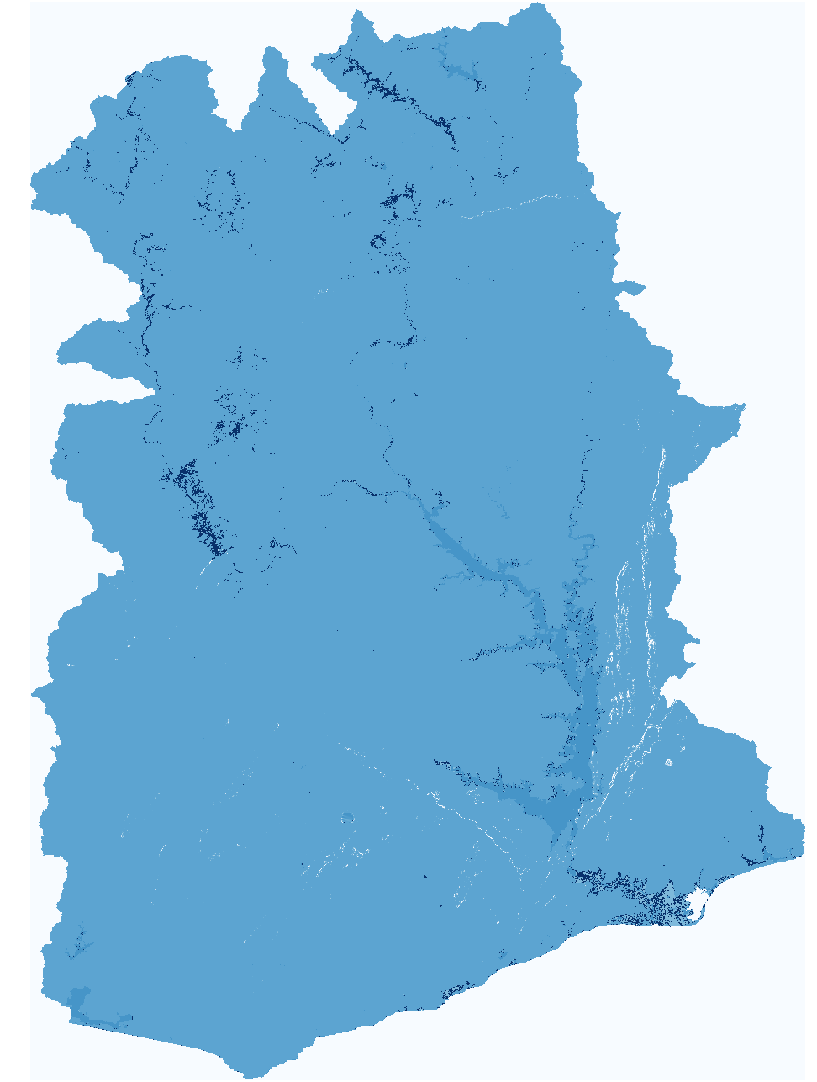
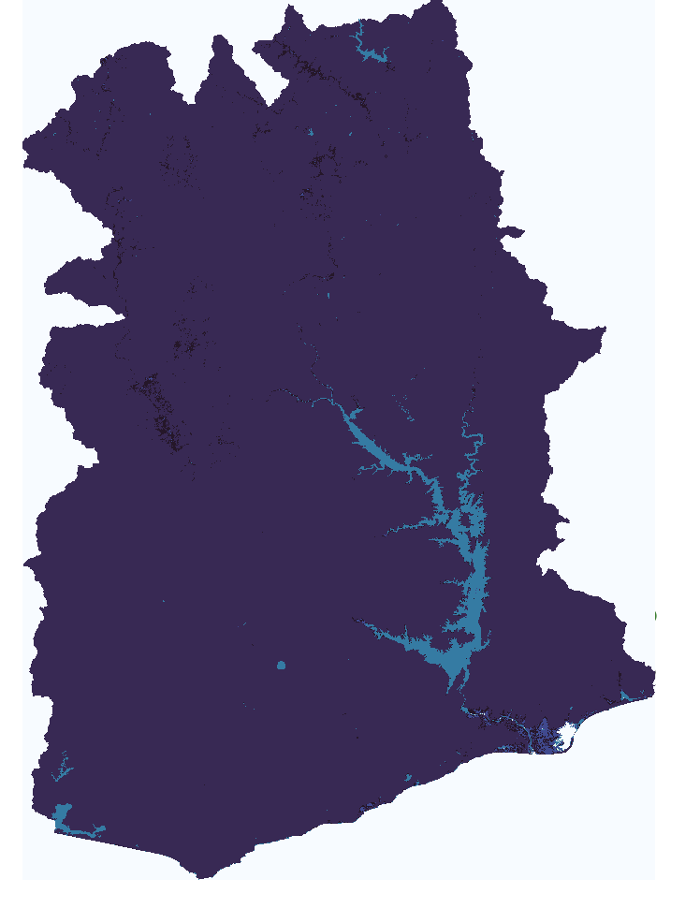
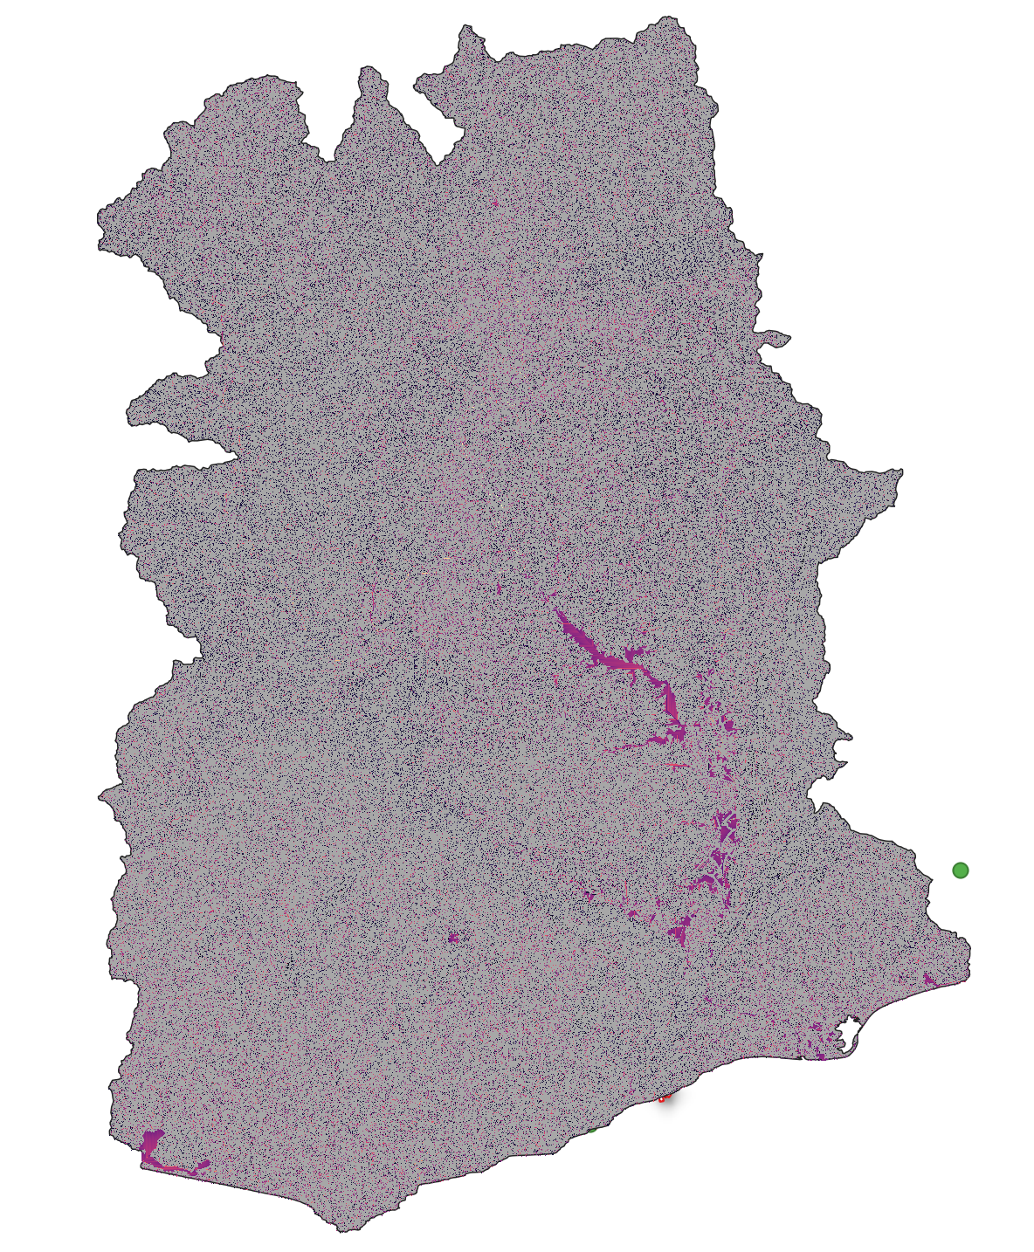
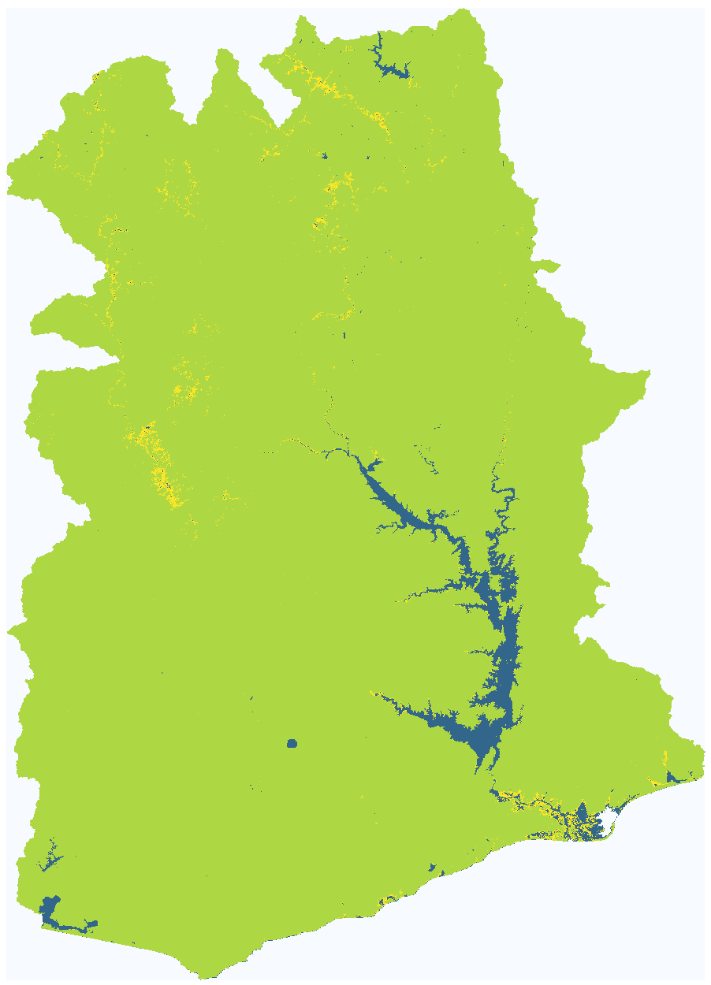
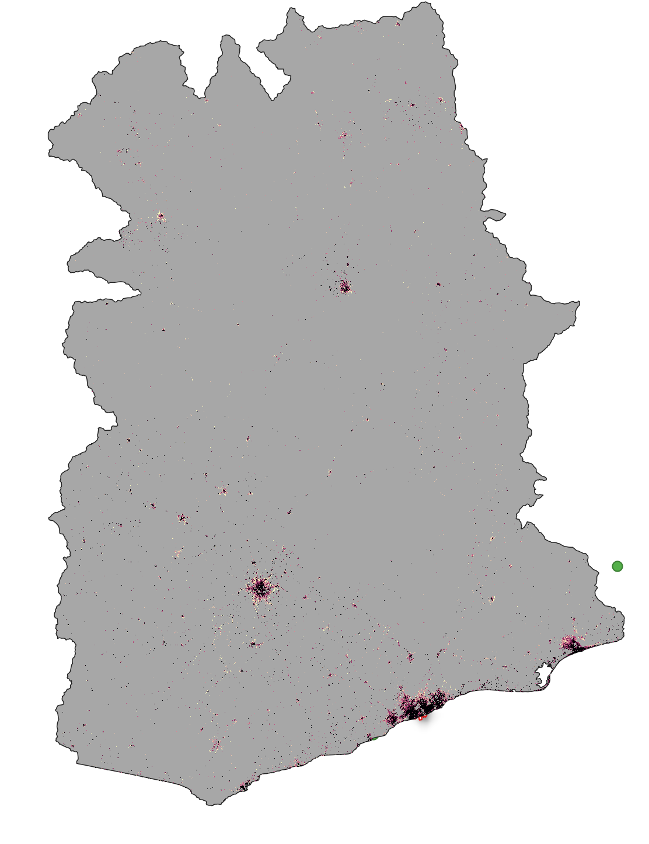
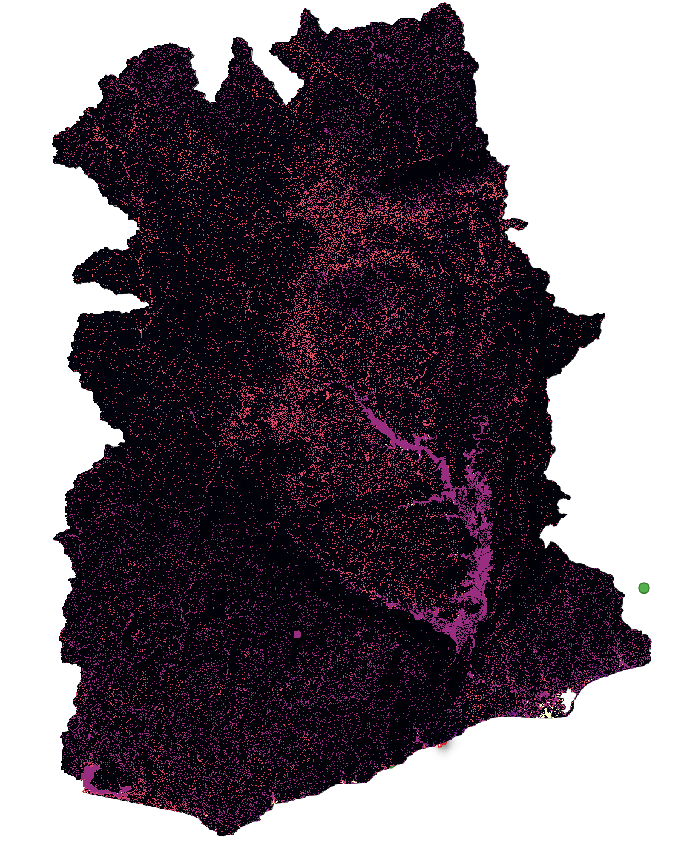
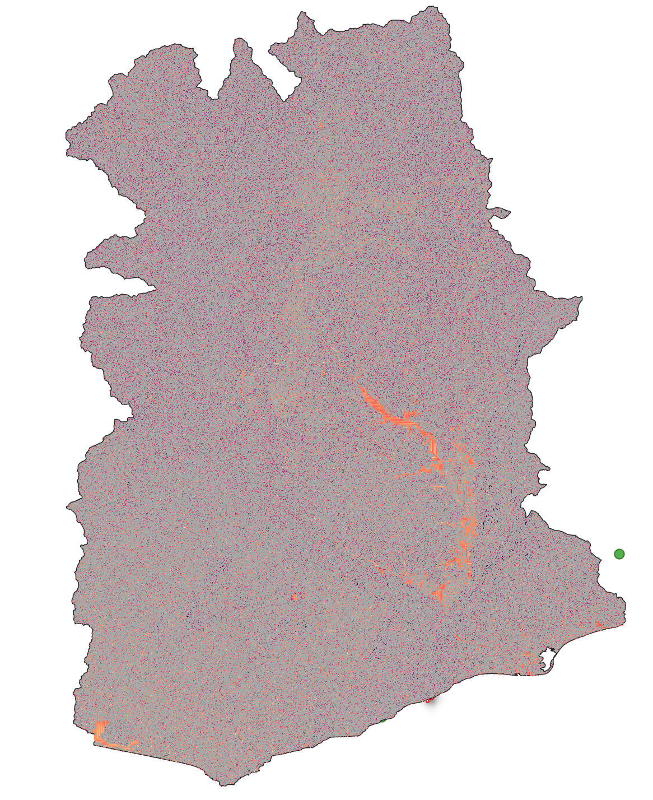
Ghana90m Baseline
wm
ksat
alpha
b
im
alpha0
beta

Slide 4
Manual pixel correction was performed for all stations (for both models 1 km and 90m).
Data analysis and cleaning was performed, obtaining the series with which we want to calibrate/validate both models.
Ghana 90m:
New impervious surface layer was processed (improving model performance).
Baseline for Ghana90m ready.

Slide 5
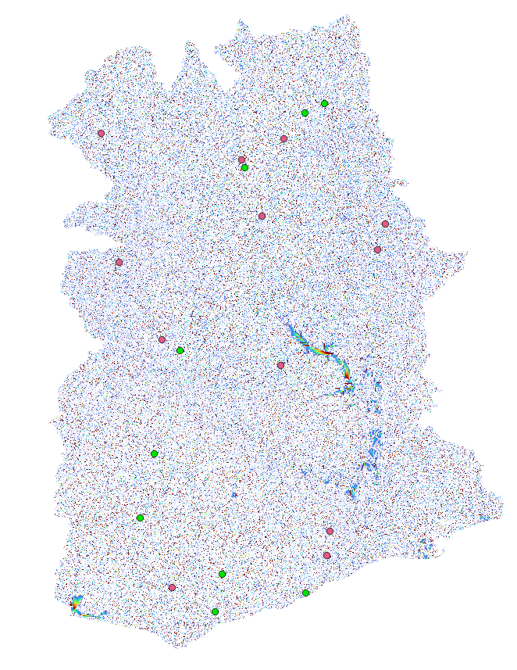
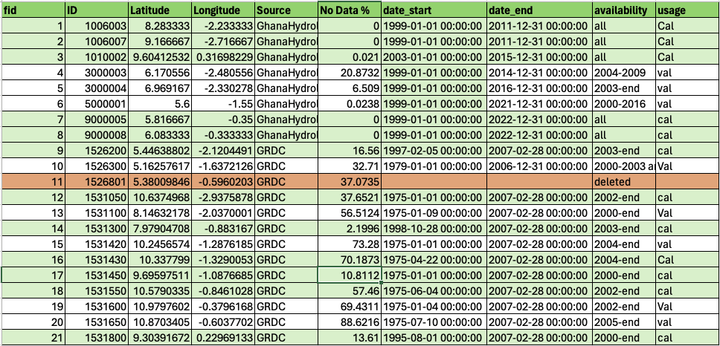
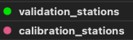
Gauge stations at 90m.
We currently have 21 stations.
We run with 20 stations:
12 for calibration, 8 for validation

Slide 6
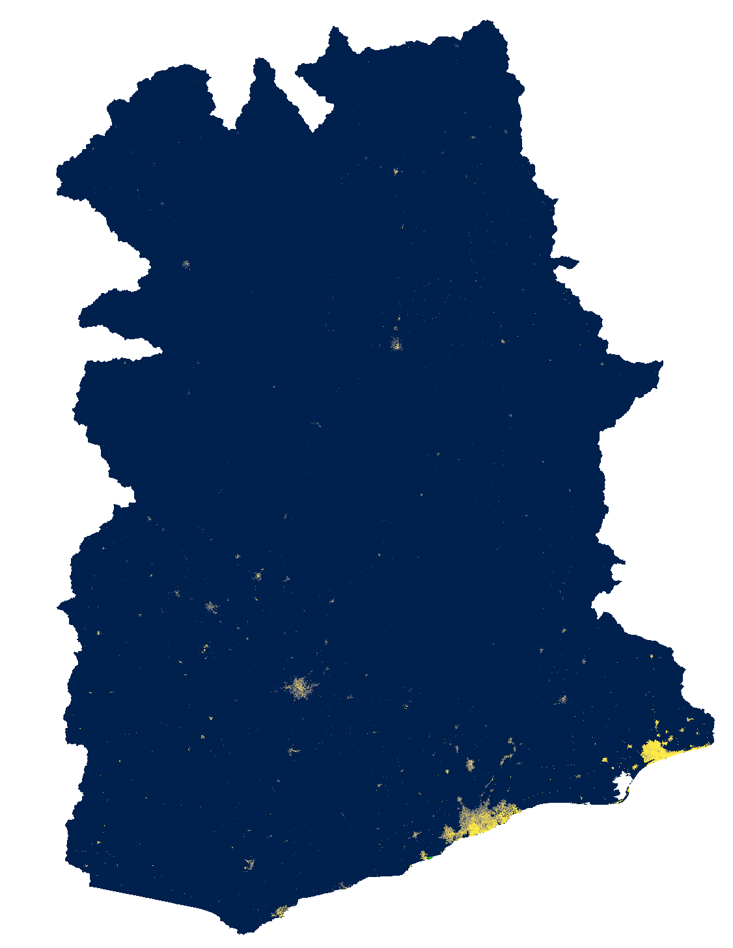
Global Man-made Impervious Surface (GMIS) Dataset From Landsat, v1 (2010)
Spatial resolution: 30m spatial resolution. The spatial extent covers the entire globe except Antarctica and some small islands. This dataset is the first global, 30m dataset of man-made impervious cover to be derived from the GLS data for 2010 and is a companion dataset to the Global Human Built-up And Settlement Extent (HBASE) dataset.
Data values: Percent imperviousness (0-100)
Limitations: The GMIS/HBASE datasets are derived directly from Landsat imagery from the Global Land Survey (GLS) 2010 dataset (Gutman et al. 2013). The quality of the GMIS/HBASE datasets is impacted by limitations of the selected GLS 2010 imagery and still contain residual cloud covered areas and areas where gaps caused by the Landsat 7 Scan Line Corrector (SLC) failure have not been successfully filled. The SLC gaps can cause visual features to appear in the data at different zoom levels. Areas where the gaps still persist or where cloud cover/cloud shadows were found have been coded as “NoData" (i.e. value = 255).
Processing: Data was processed by interpolation the NoData values.
Brown de Colstoun, E. C., C. Huang, P. Wang, J. C. Tilton, B. Tan, J. Phillips, S. Niemczura, P.-Y. Ling, and R. E. Wolfe. 2017. Global Man-made Impervious Surface (GMIS) Dataset From Landsat. Palisades, New York: NASA Socioeconomic Data and Applications Center (SEDAC).https://doi.org/10.7927/H4P55KKF.

Slide 7
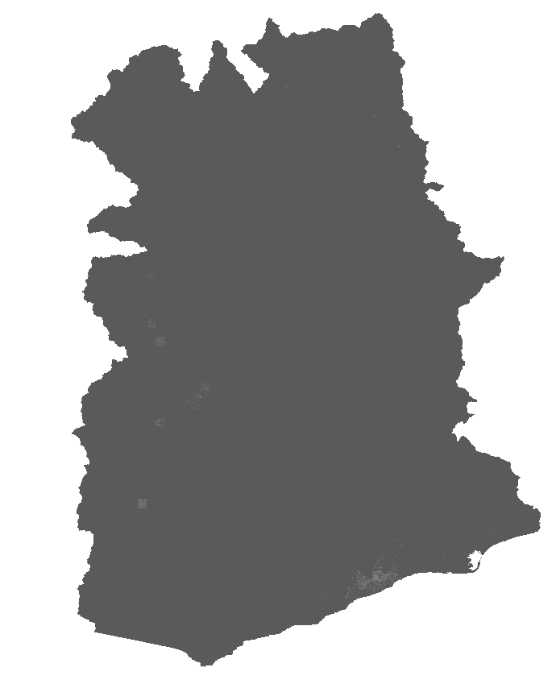
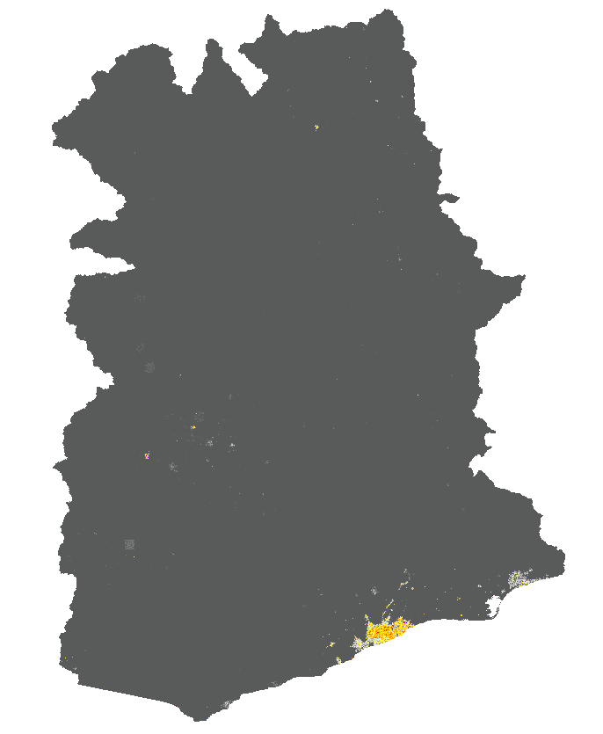
-No warmup
-New impervious surface layer
-No warmup
-Old impervious surface layer

Slide 8
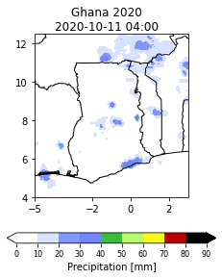
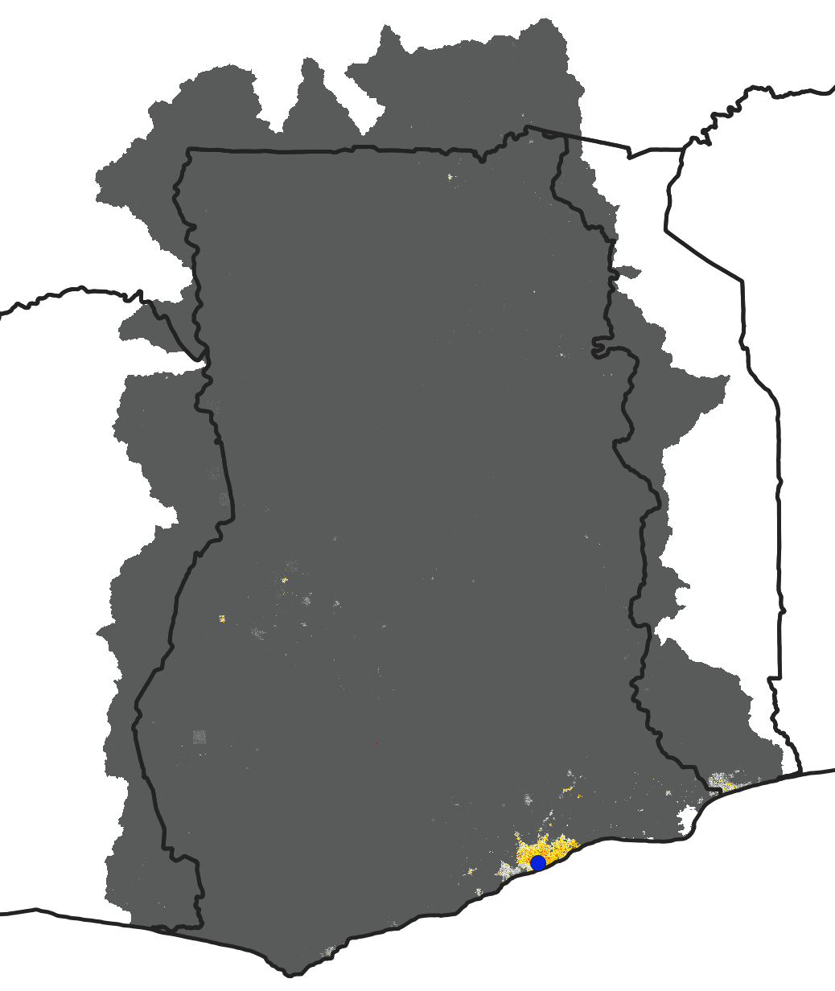
-No warmup
-Old impervious surface layer
-No warmup
-Old impervious surface layer

Slide 9
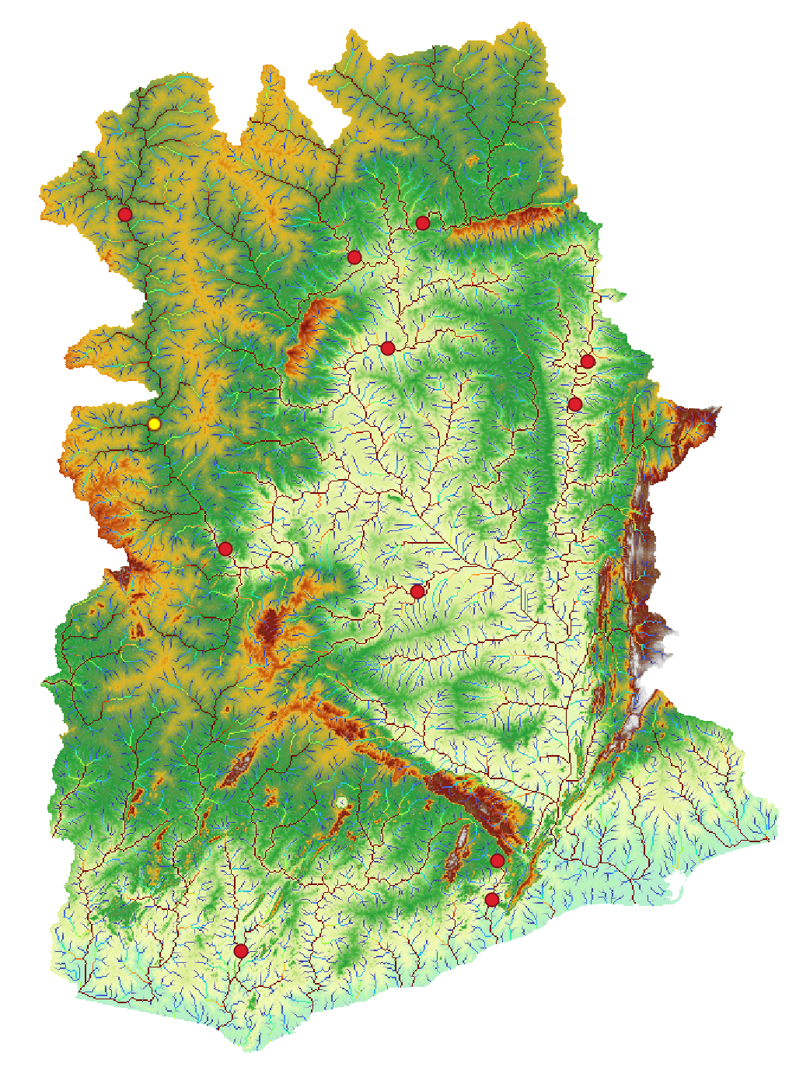
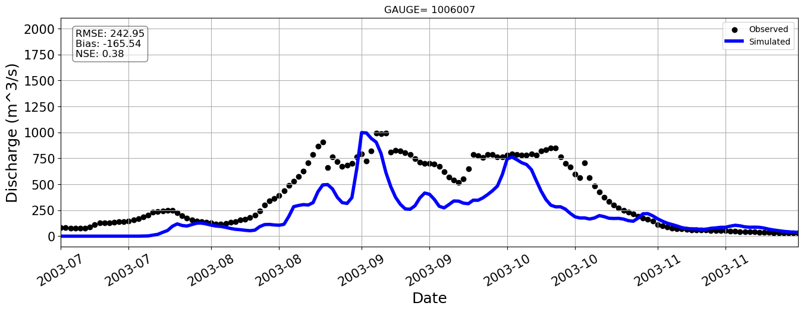
Station=1006007

Slide 10
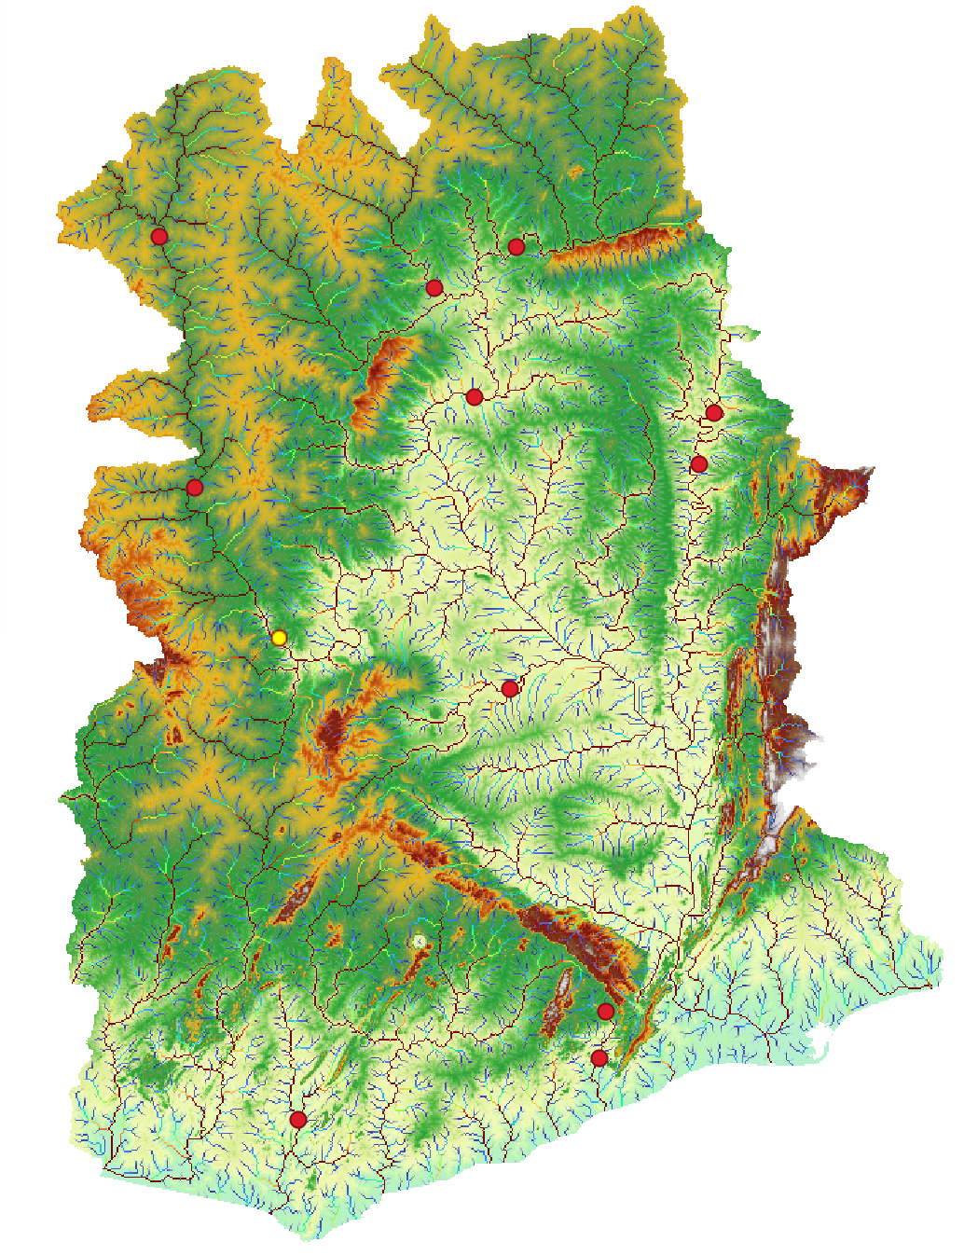
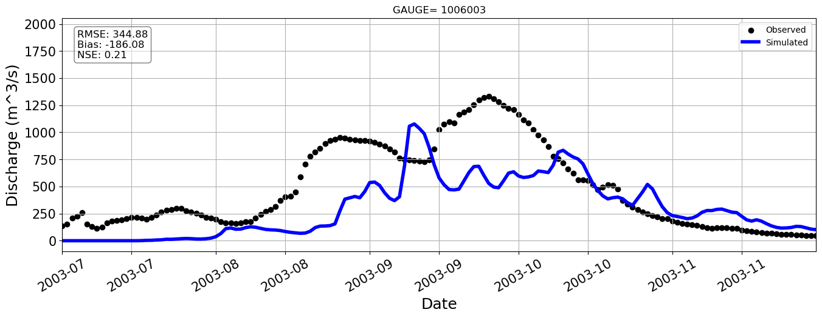
Station=1006003

Slide 11
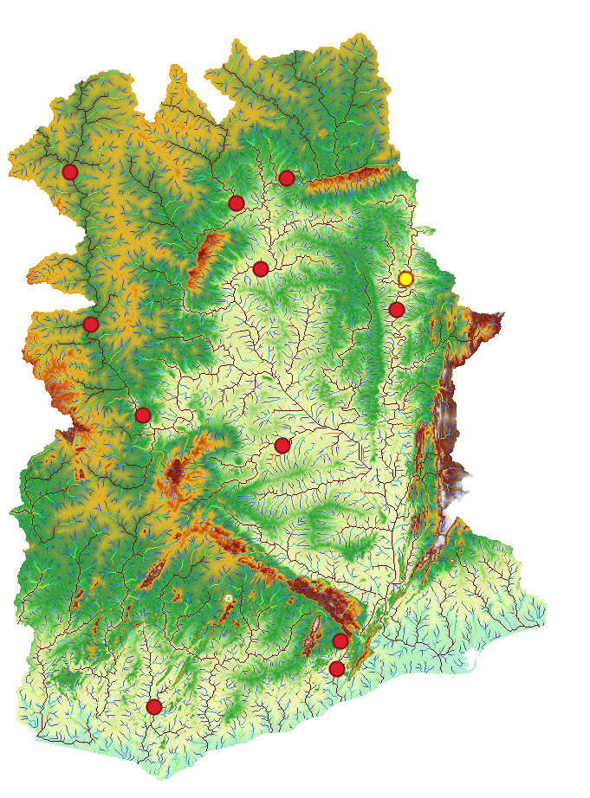
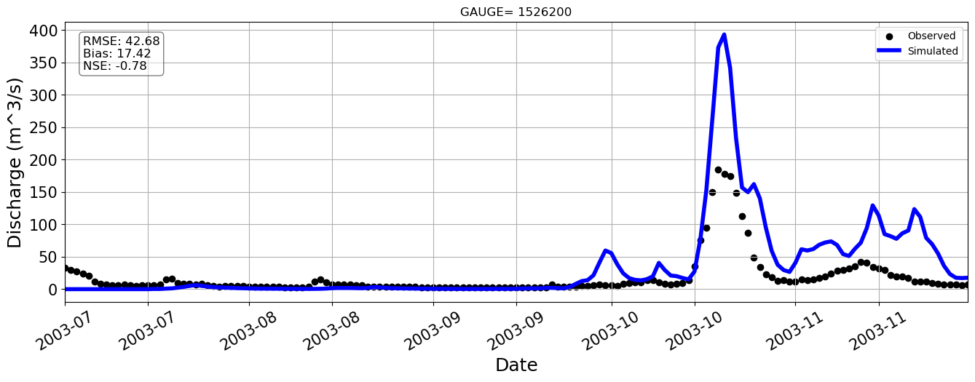
Station=1010002

Slide 12
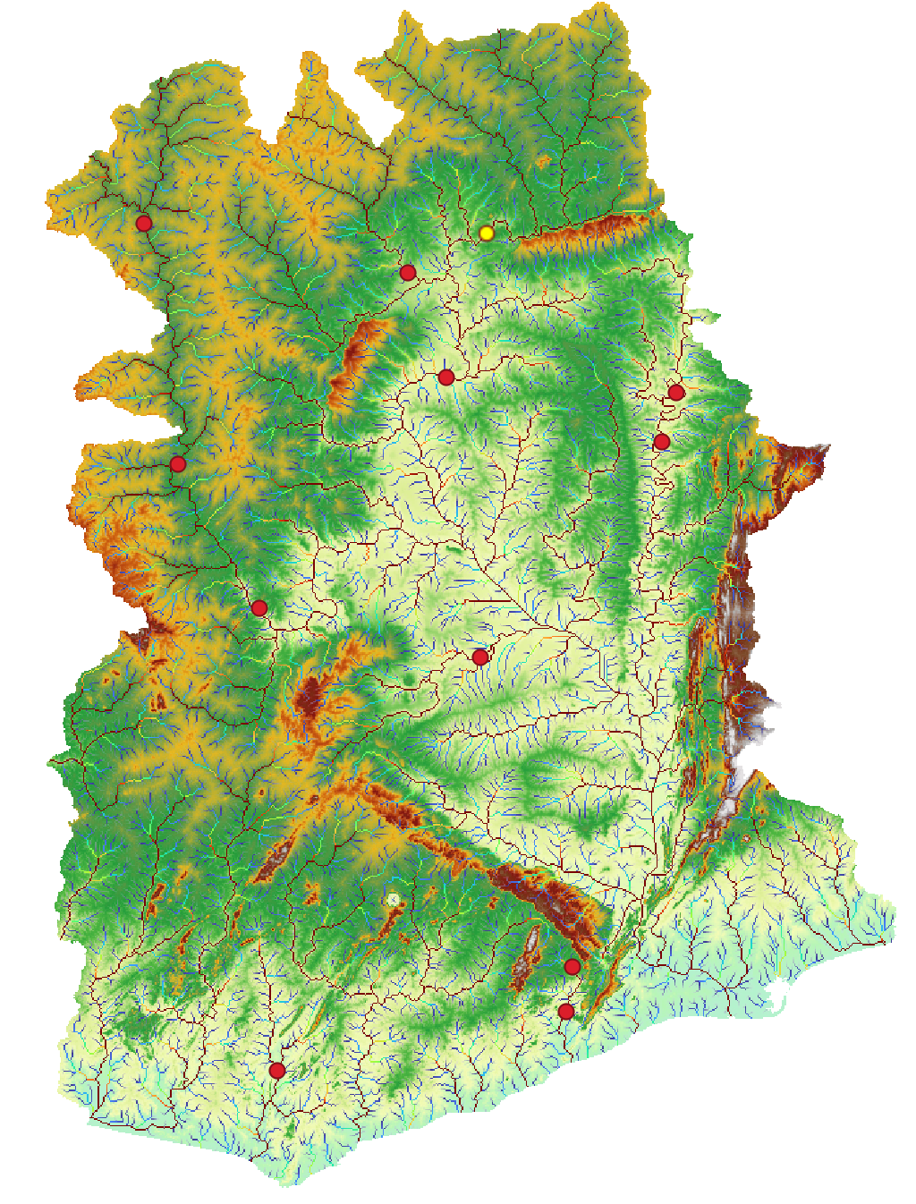
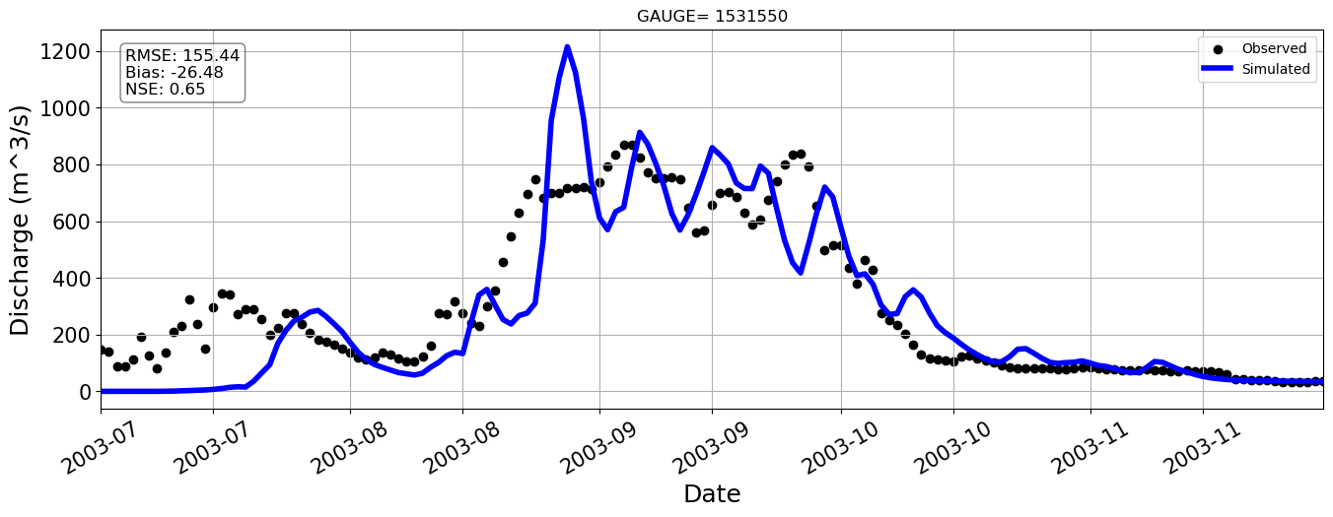
Station=1531550

Slide 13
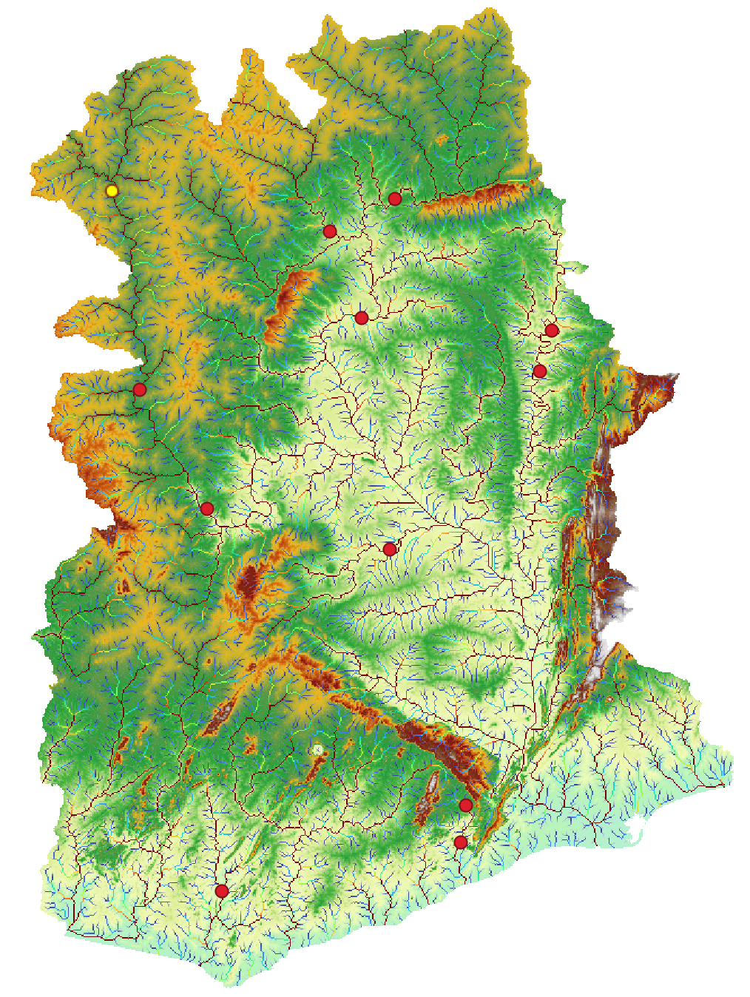
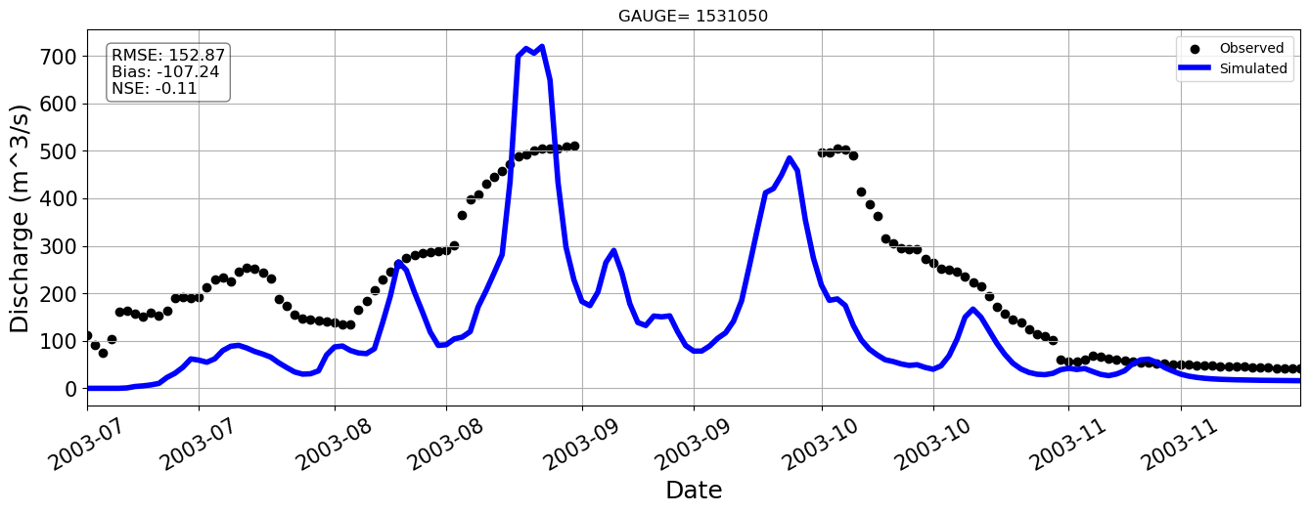
Station=1531050

Slide 14
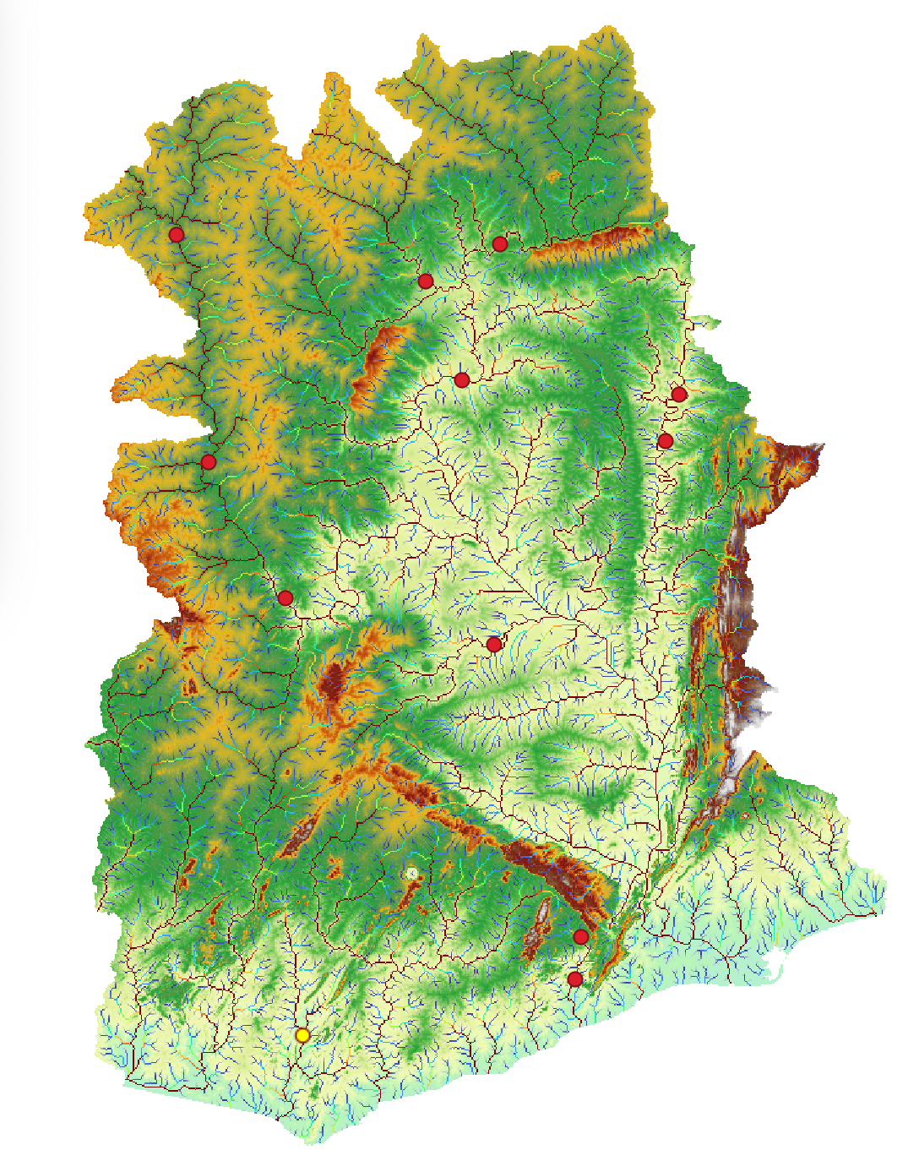
Station=1526200

Slide 15
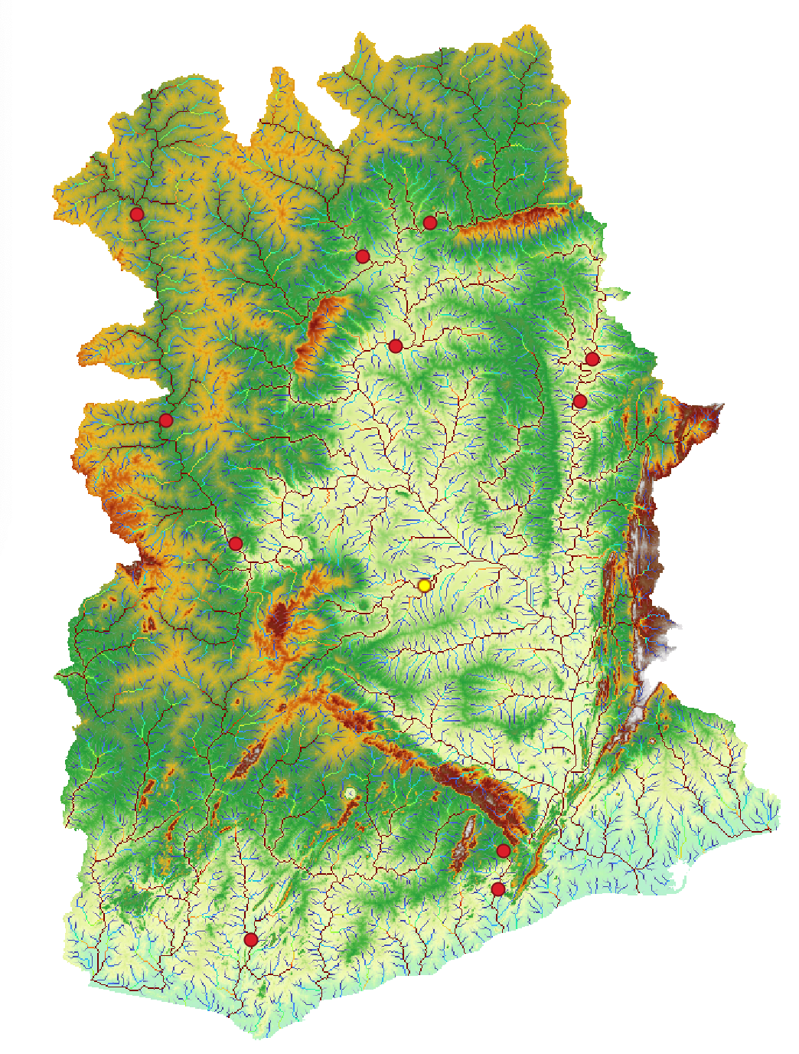
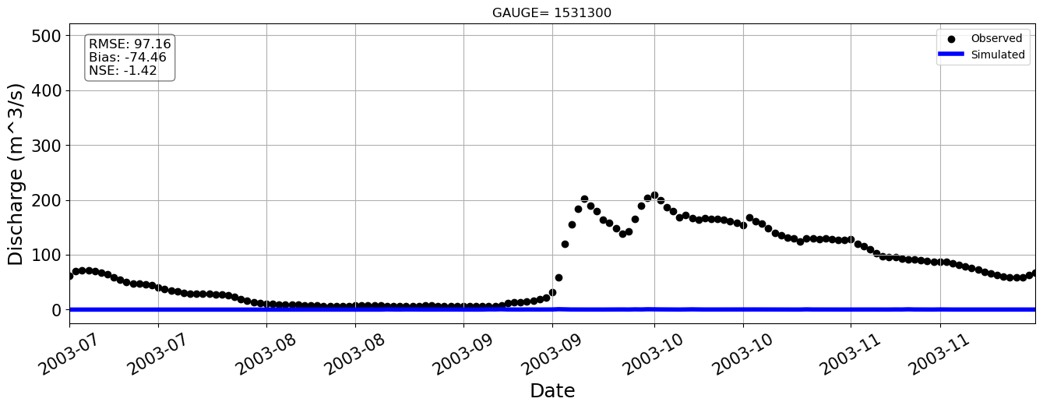
Station=1531300

Slide 16
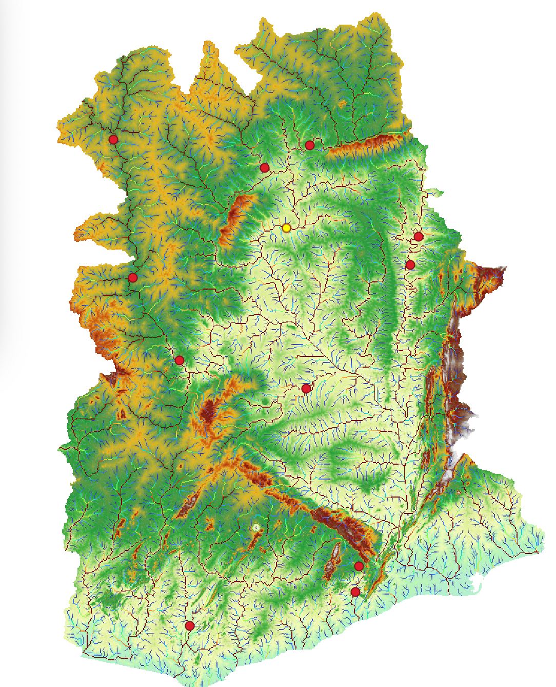
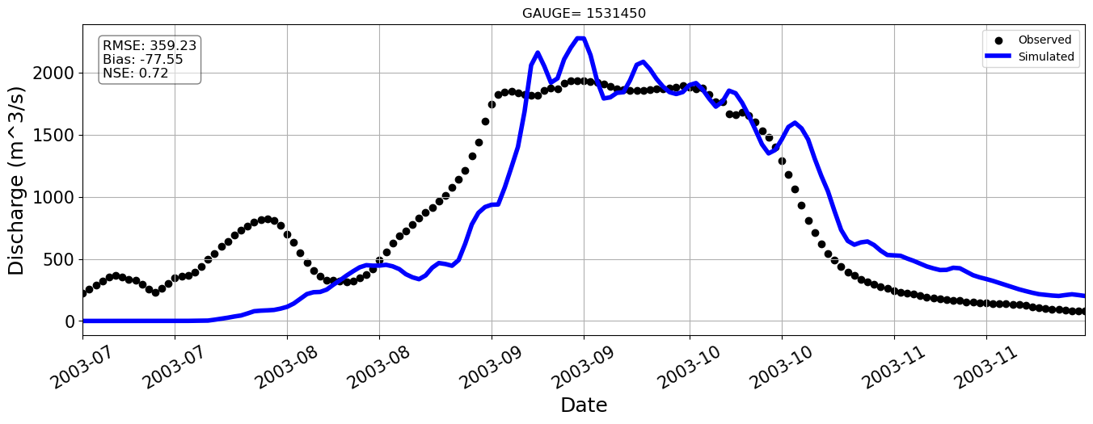
Station=1531450

Slide 17
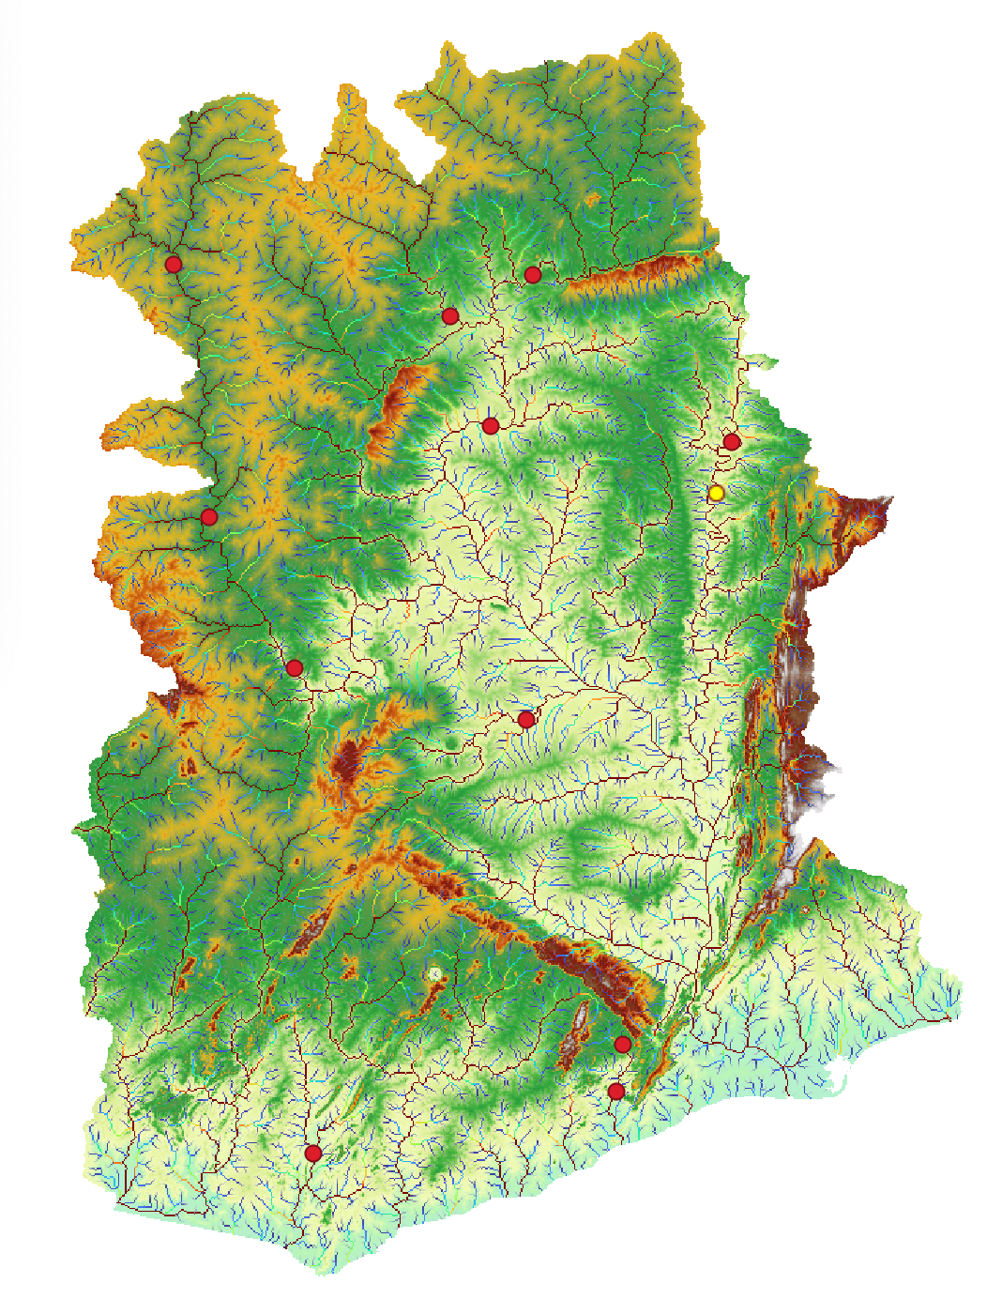
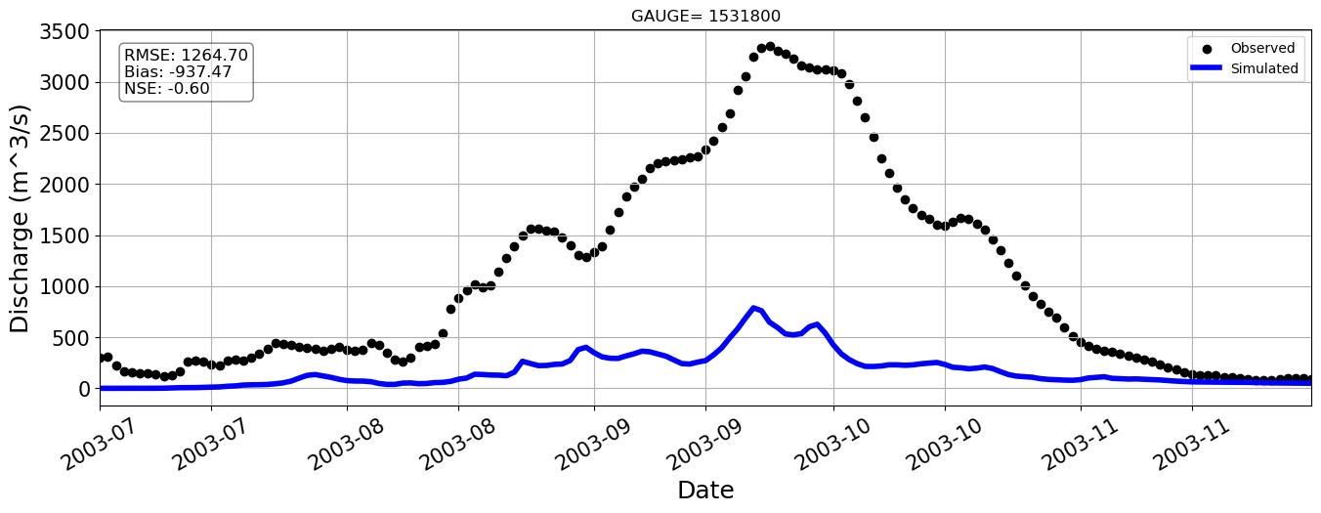
Station=1531800

Slide 18
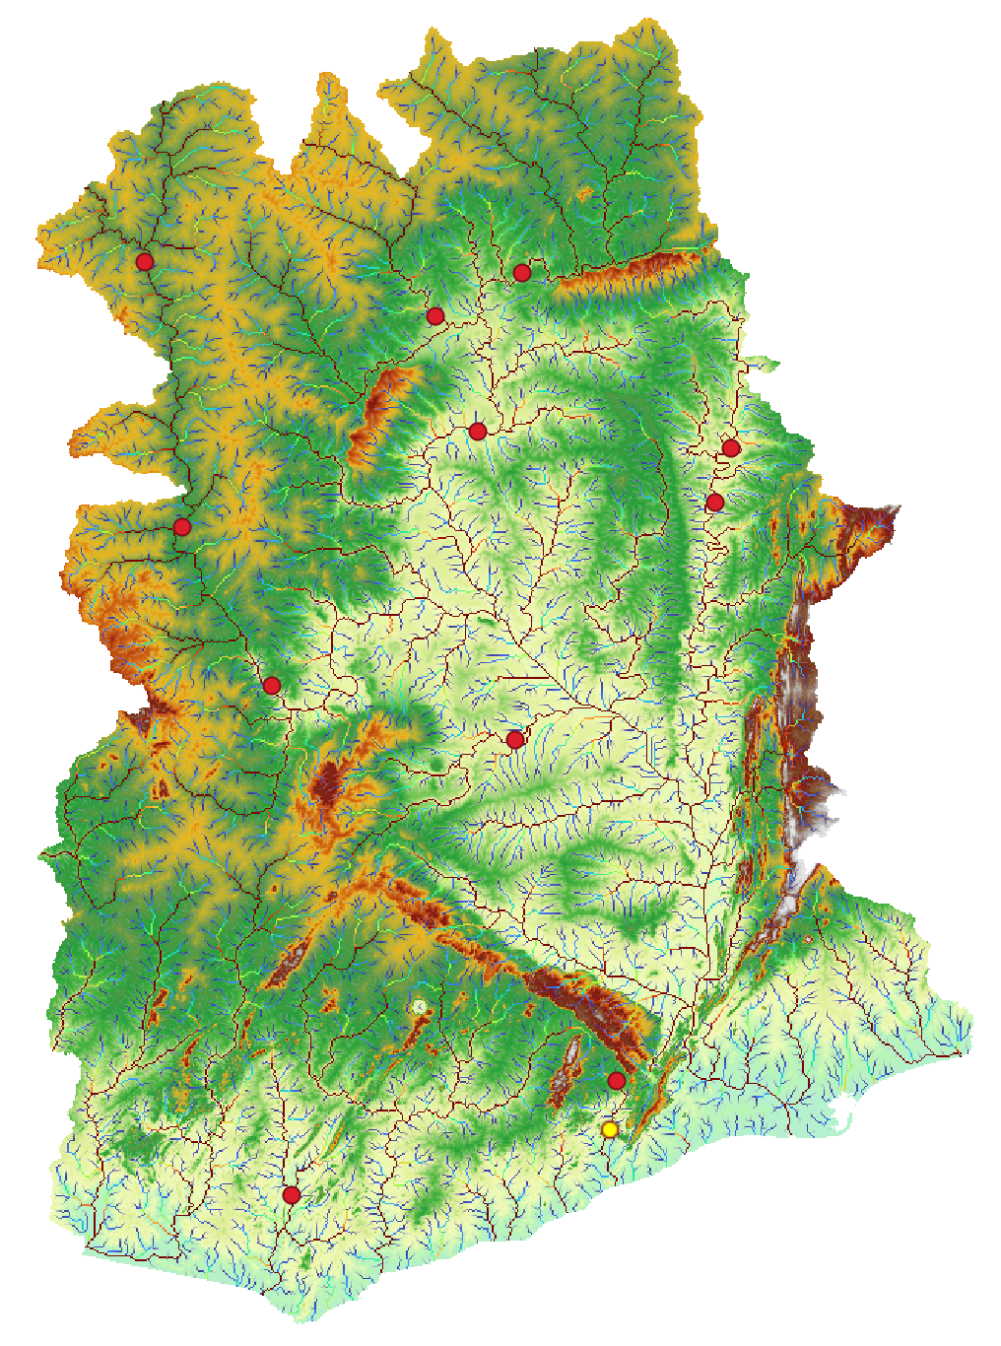
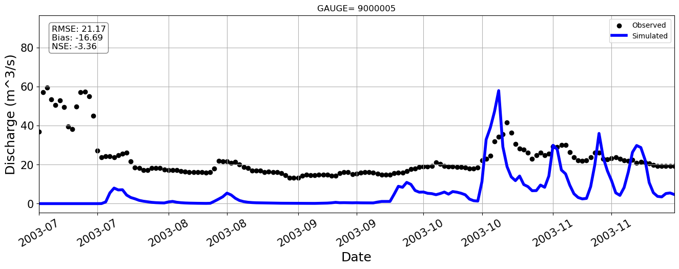
Station=9000005

Slide 19
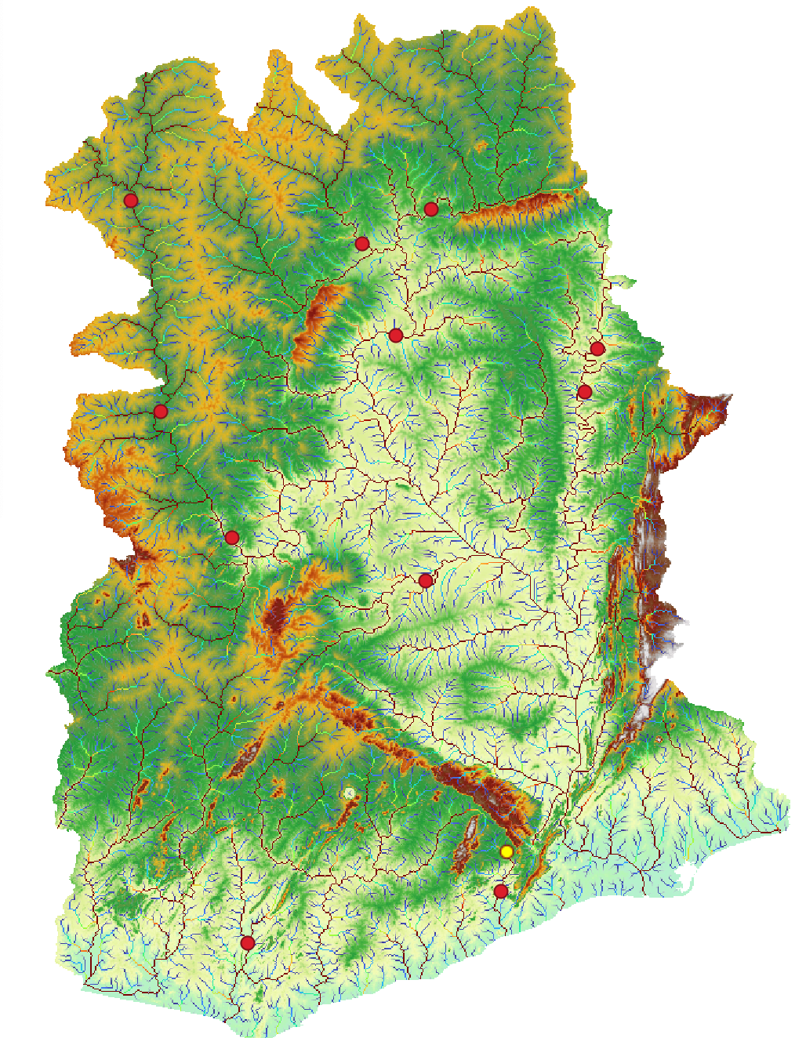
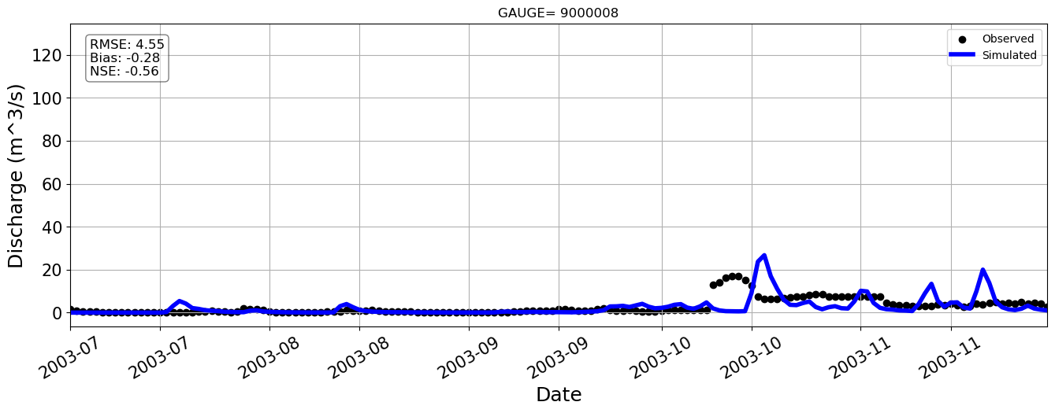
Station=9000008

Slide 20
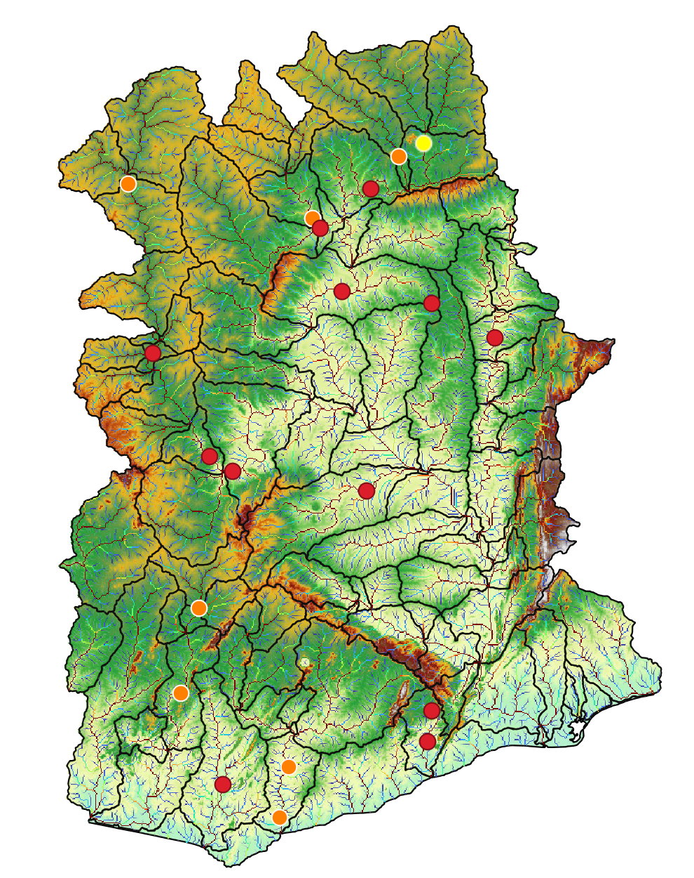
Station=1531600

Slide 21
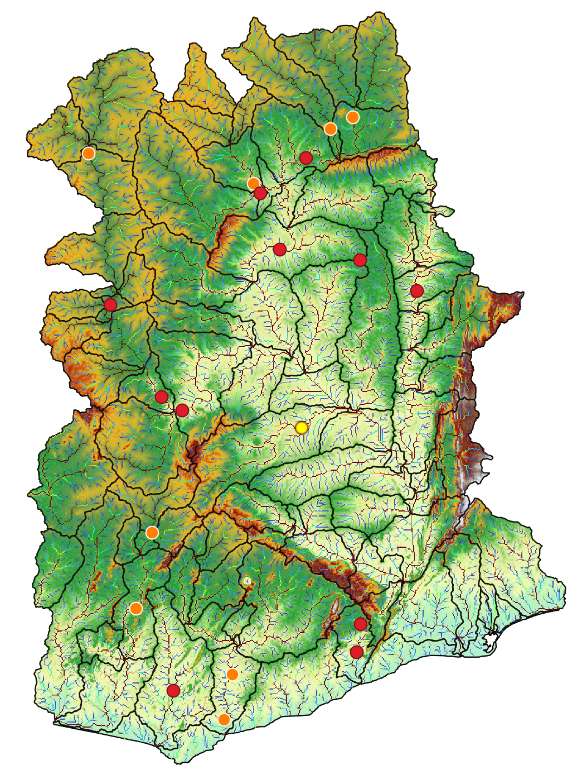
Station=1526300

Slide 22
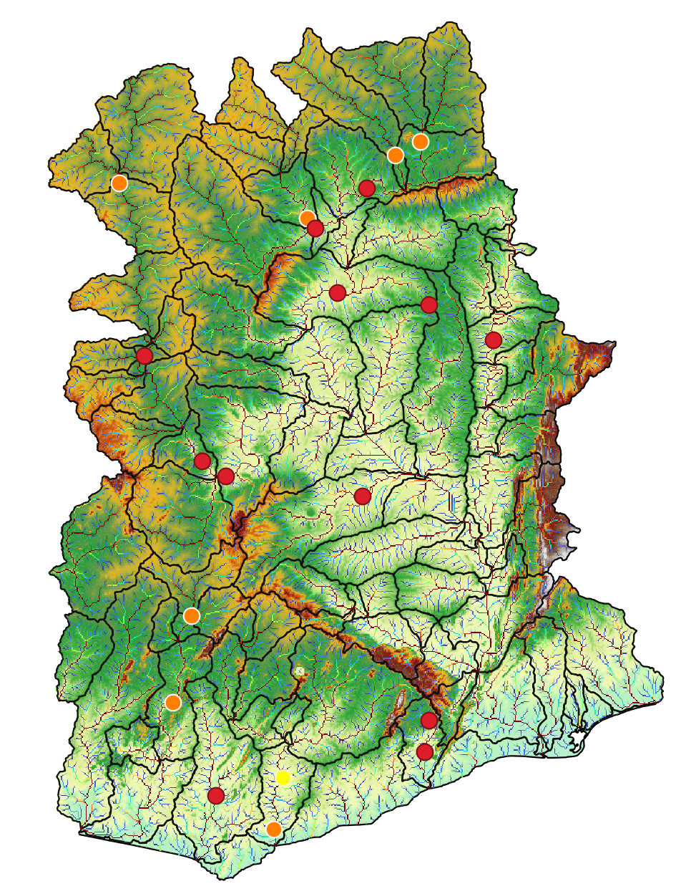
Station=5000001
Notes:
We realize that for some stations we don’t have data from the model, so we need to correct the location of the gauge.
So, this week we are going to correct that locations and run again the model to see if improves

Slide 23
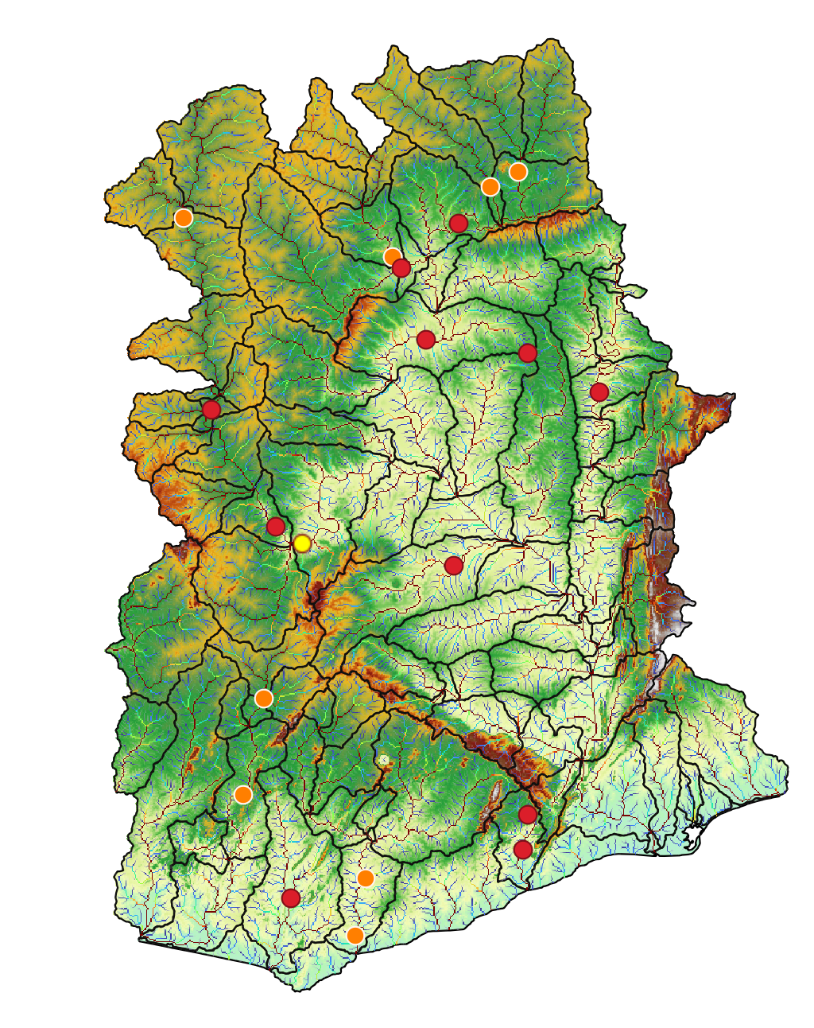
Station=1531100

Slide 24
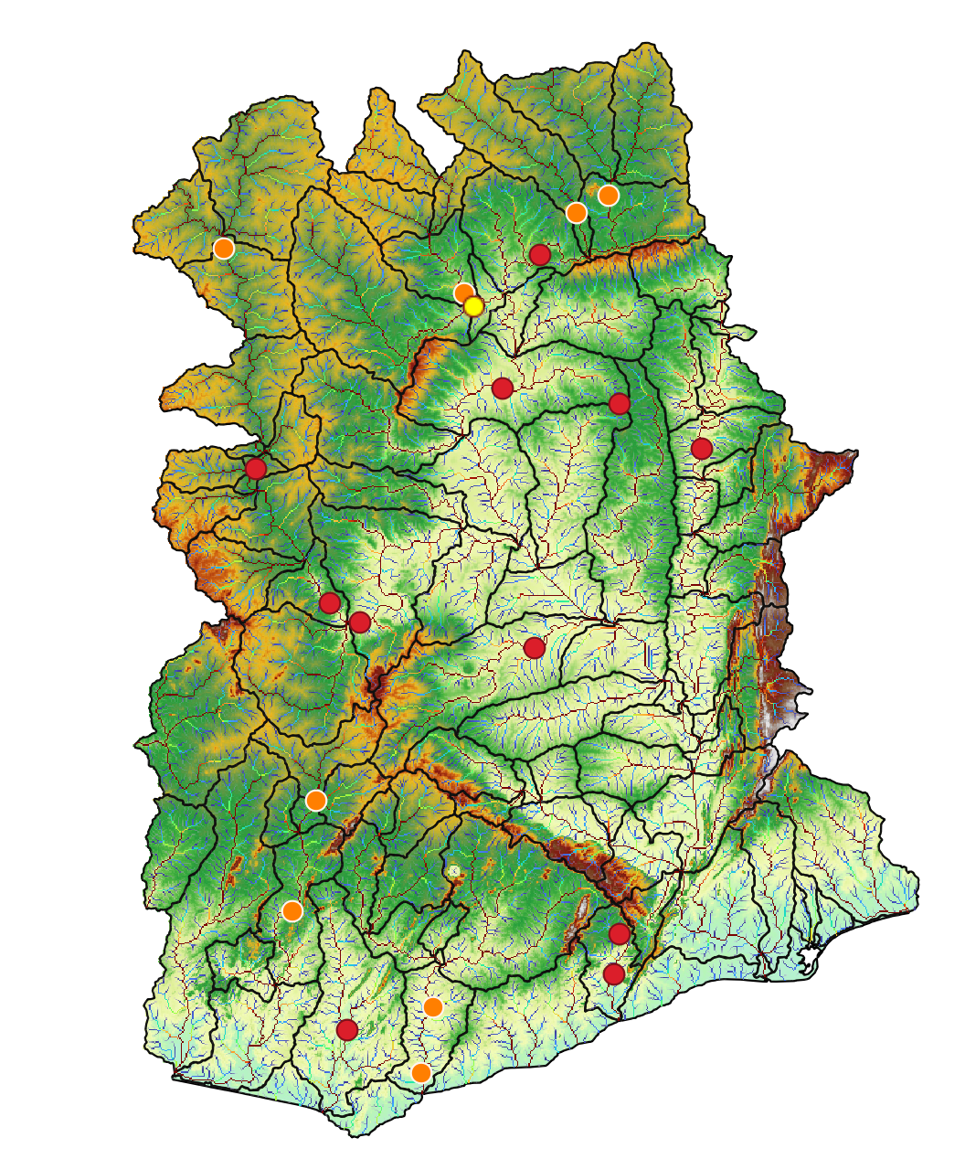
Station=1531420

Slide 25
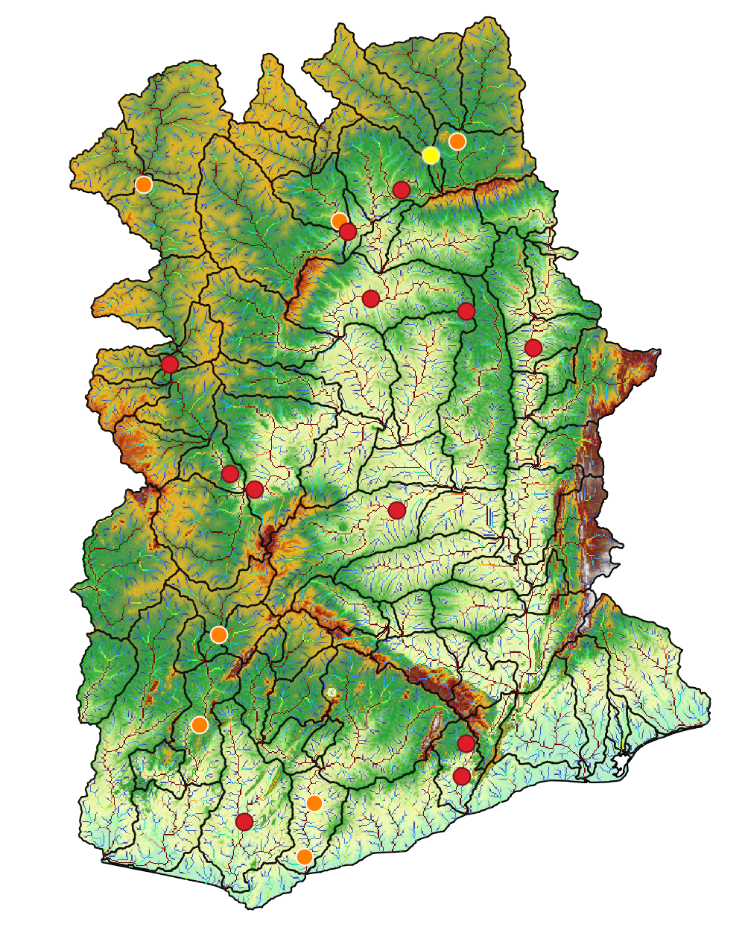
Station=1531650

Slide 26

Station=3000003

Slide 27
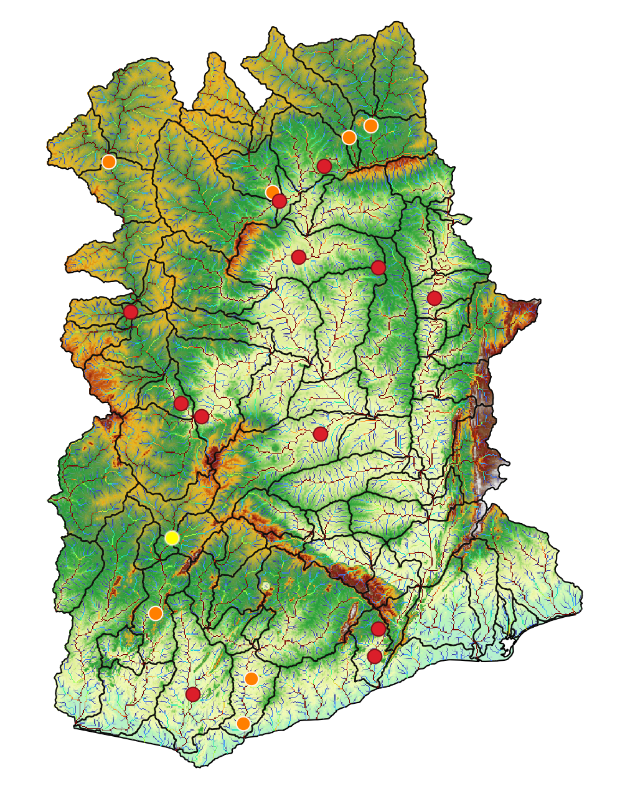
Station=3000004

Slide 28
Baseline 20 years – Ghana 90 m
Baseline 3

Slide 29
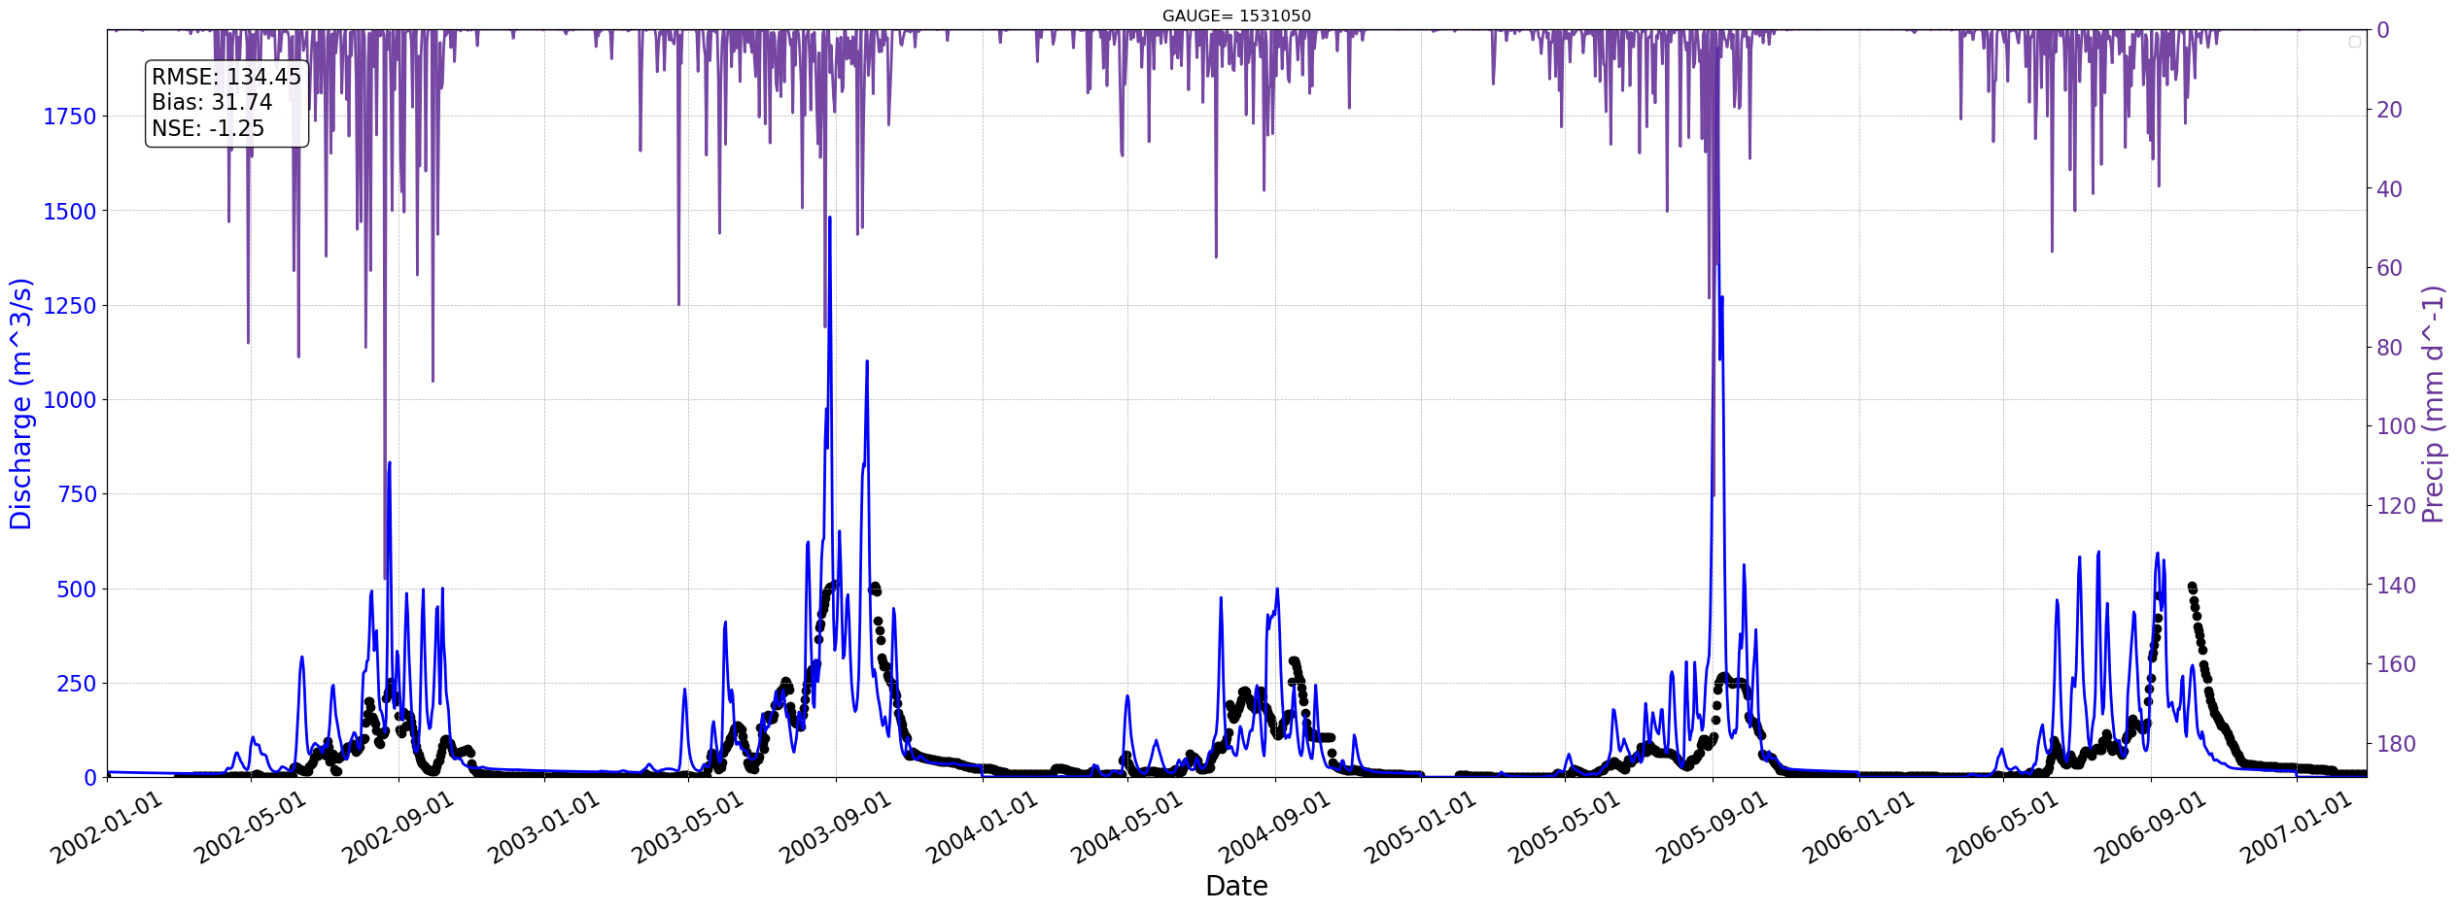
Station=1531050

Slide 30
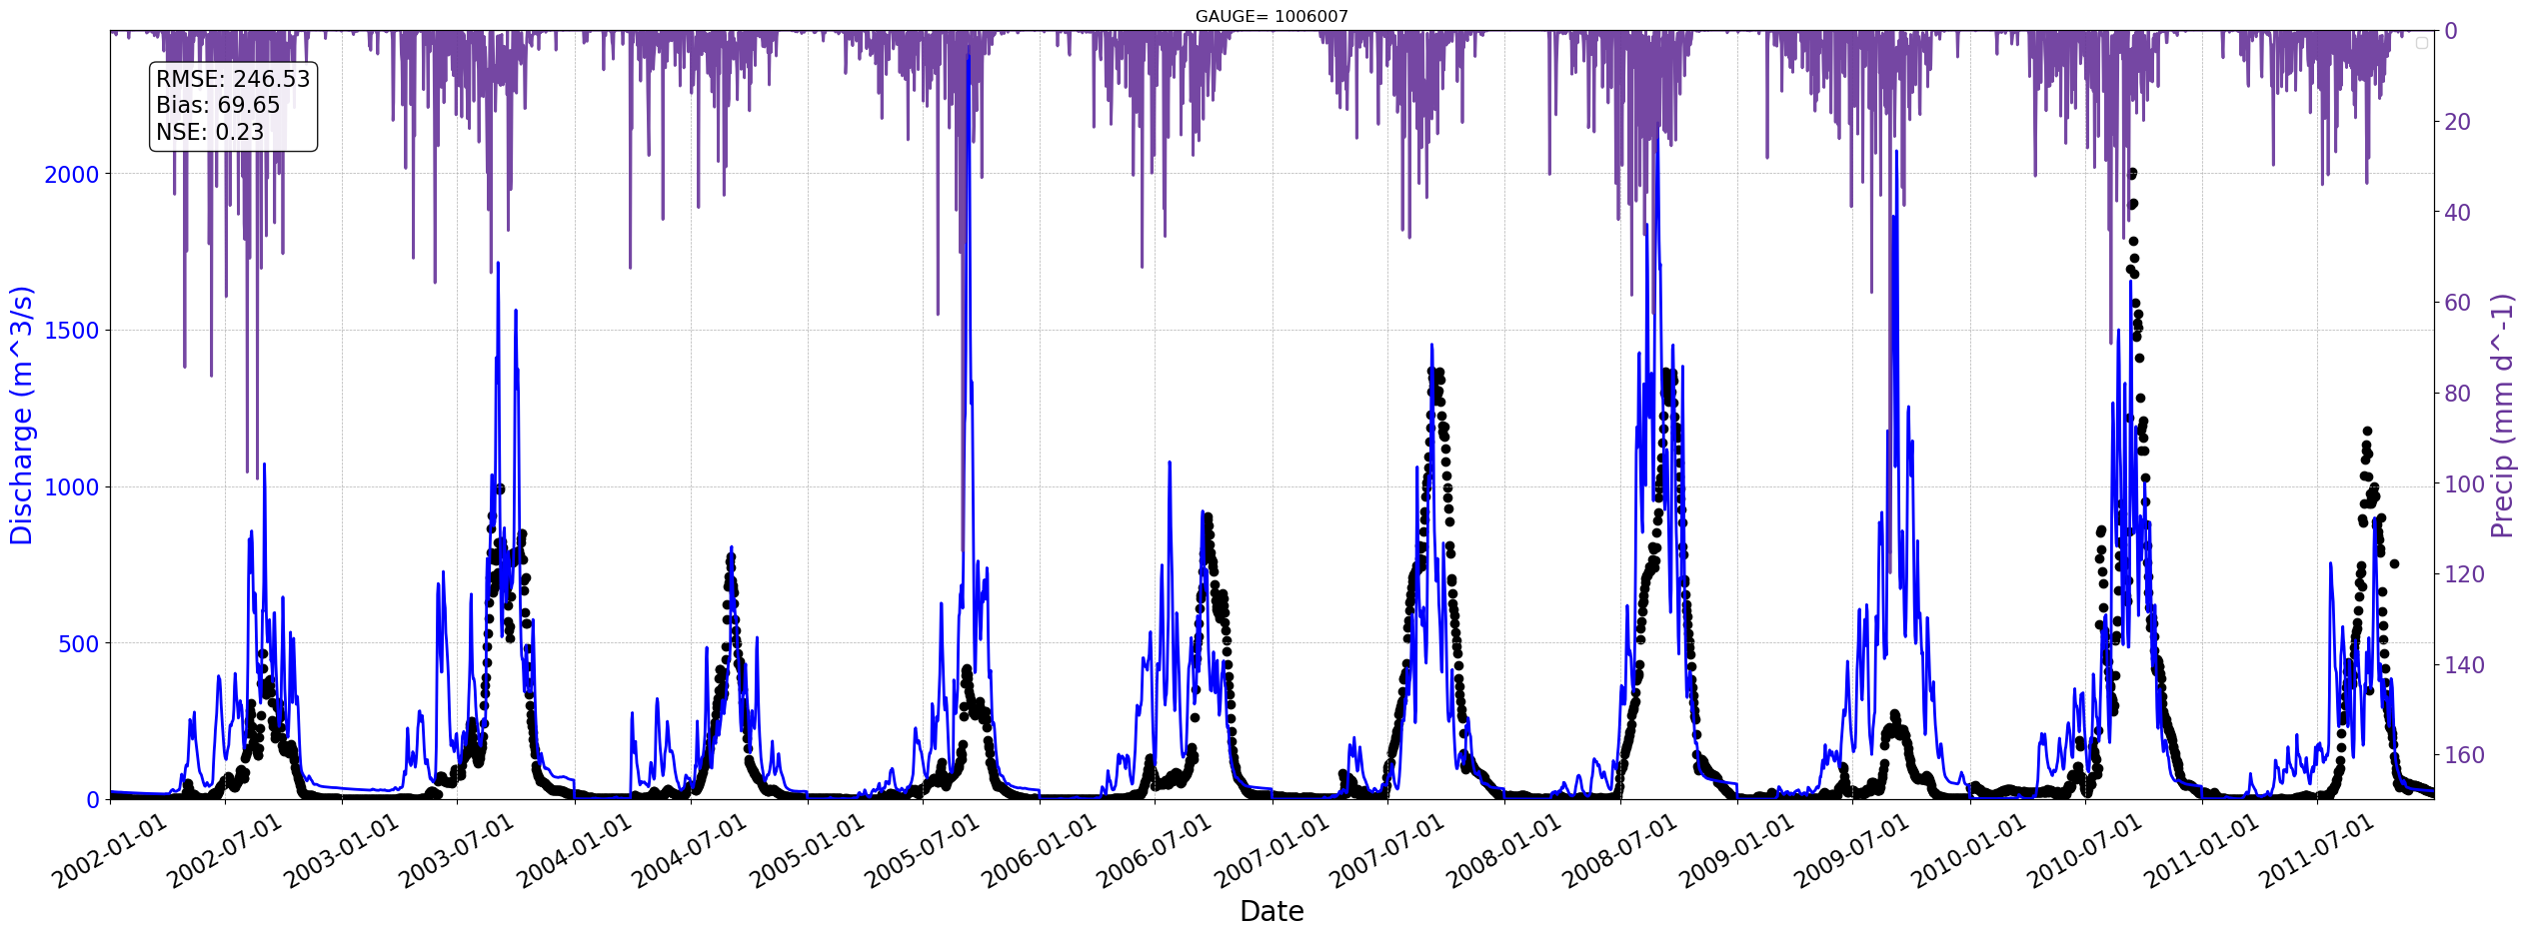
Station=1006007

Slide 31
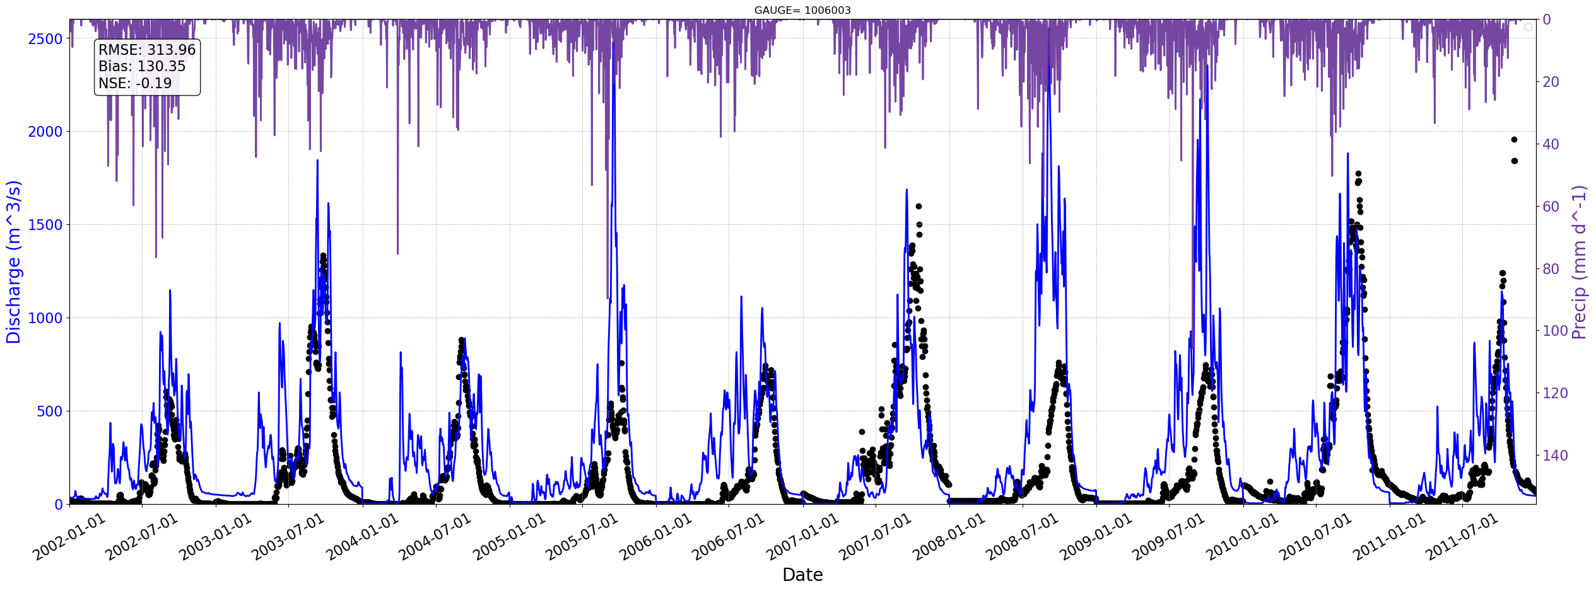
Station=1006003

Slide 32
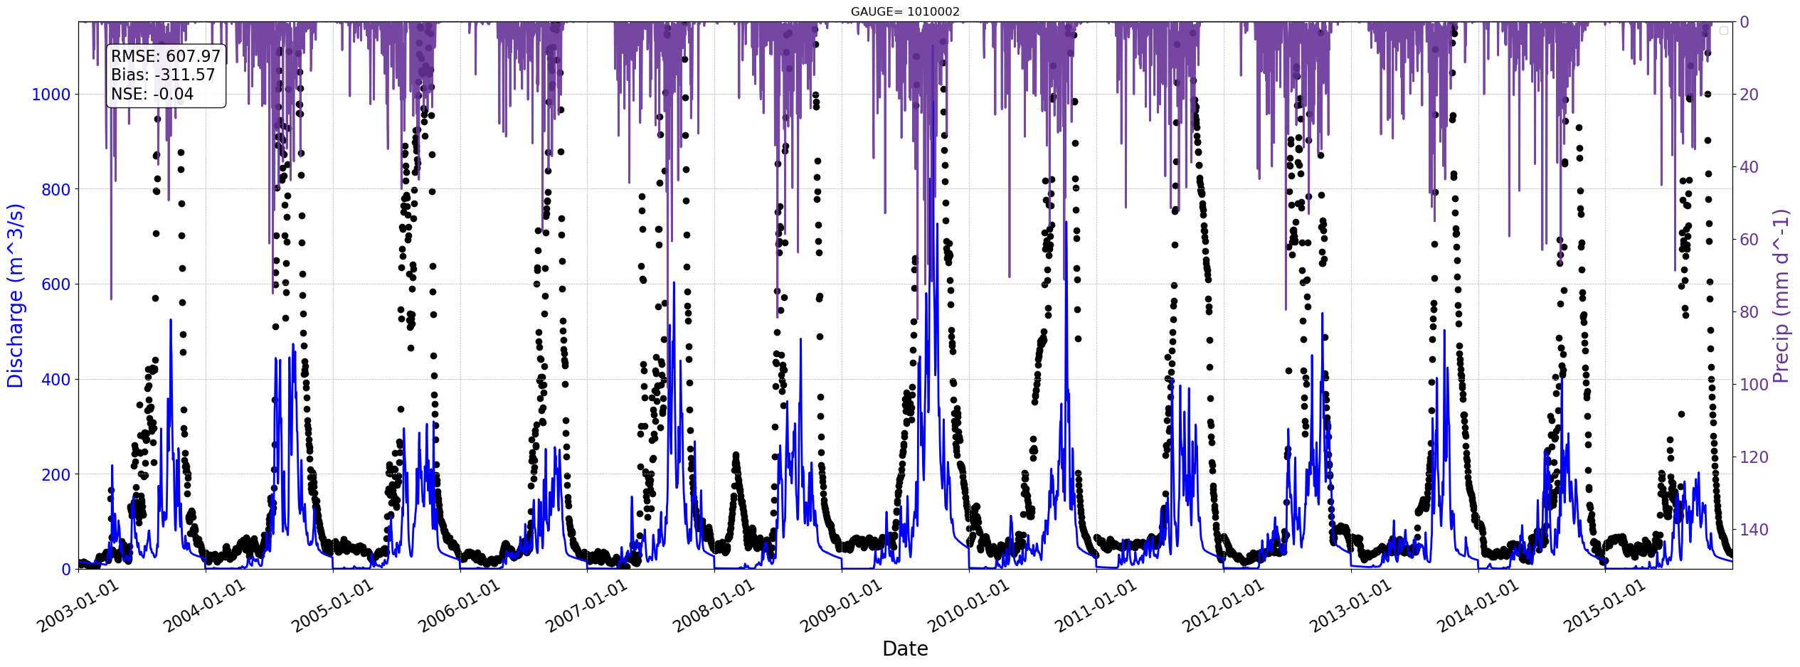
Station=1010002

Slide 33
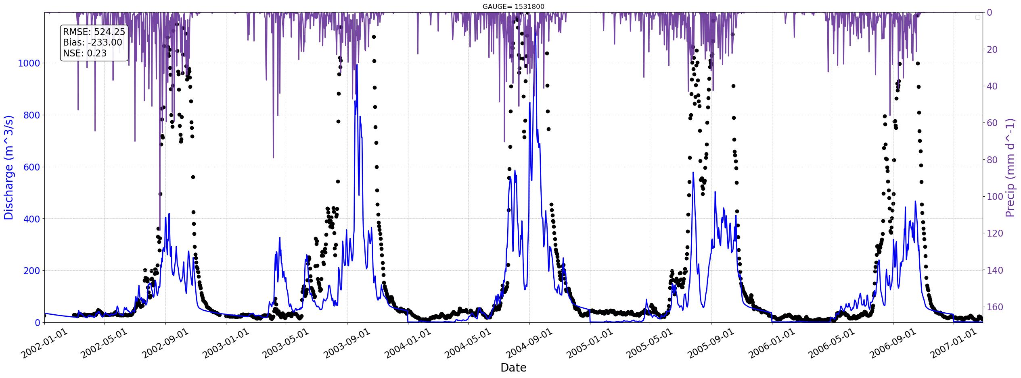
Station=1531800

Slide 34

Station=1531550

Slide 35

Station=1531450

Slide 36

Station=1531300

Slide 37

Station=1526200

Slide 38

Station=9000005

Slide 39

Station=9000008

Slide 40


Slide 41
Seasonal evaluation
Baseline 3 20 years – Ghana 90

Slide 42



Slide 43


Slide 44





Slide 45




Slide 46
Next Calibration:
Run again but changing PET.
New Model covering northern regions.

